Slide 1
US05CPHY05
UNIT - IV
Operational Amplifier
[OpAmp]

Slide 2
US05CPHY05 UNIT - IV
Operational Amplifier [OpAmp]
Reference Book: Integrated Circuits
              K R Botkar

Slide 3
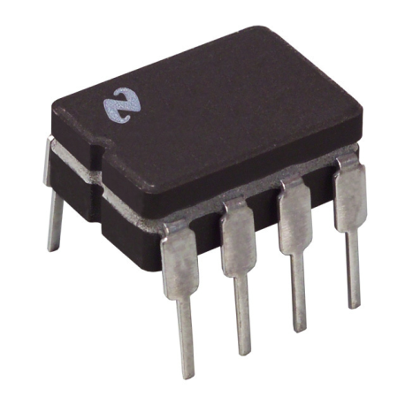
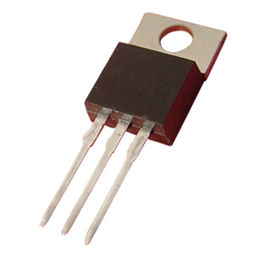
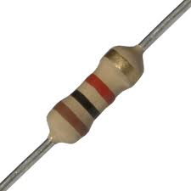
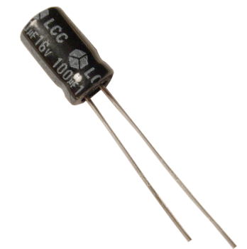
What is an Op-Amp?
An Operational Amplifier (known as an “Op-Amp”) is a device that is used to amplify a signal using an external power source.
Op-Amps are generally composed of:
  Transistors, Resistors, Capacitors
= + +

Slide 4
Applications of Op-amp
Summing Amplifiers
AC and DC signals application
Digital-to-Analog converters
Analog computers
Active filters [Low-Pass and High-Pass Band-Pass Filters]
Oscillators
Regulators
Rectifiers
Comparators
Integrators and Differentiators etc.

Slide 5
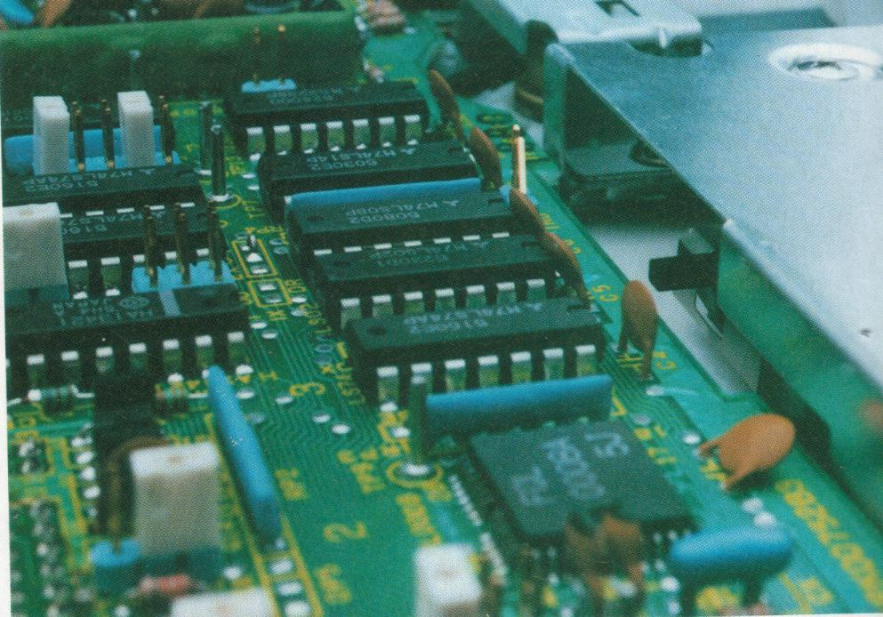
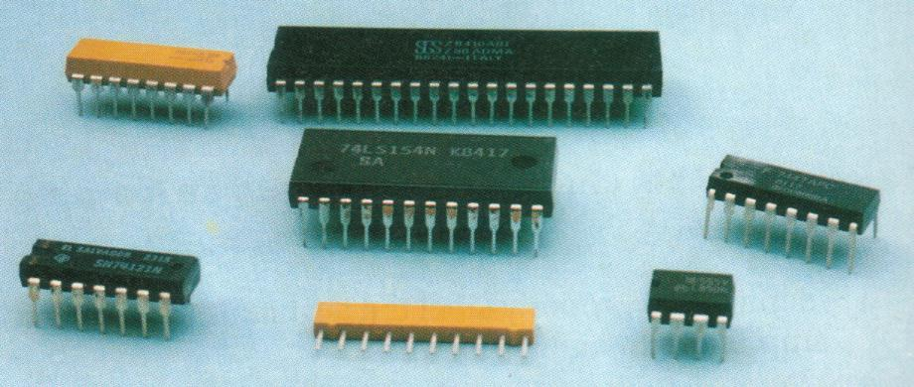
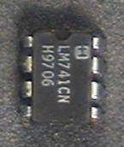
Typical IC packages
IC packages placed on circuit board
Amplifier with ICs:
  Reliable
  Reduced Cost
  Reduced Size
  High Noise Reduction Capacity

Slide 6
Introduction- Operational Amplifier (Op-Amp)
It is an integrated circuit that uses external voltage to amplify the input through a very high gain.
Op-amps are used to model the basic mathematical operations; addition, subtraction, integration and differentiation in electronic analog computers.

Slide 7
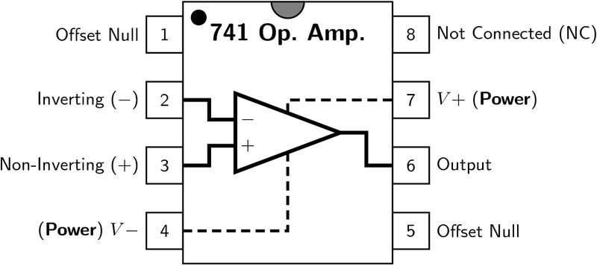
There are 8 pins in a common Op-Amp, like the 741.

Slide 8
Ideal Operational Amplifier
Ideal op-amp is characterized by:
4. Zero output voltage when input is voltage is zero.
5. Infinite CMRR.

Slide 9
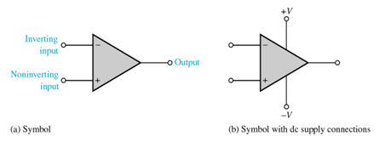
2
7
6
4
3

Slide 10
Op-Amp Input Modes
Single-Ended Input Mode
Input signal is connected to ONE input and the other input is grounded.
Non- Inverting Mode
input signal at +ve terminal → output same polarity as the applied input signal
Inverting Mode
input signal at –ve terminal → output opposite in phase to the applied input signal

Slide 11
Op-Amp Input Modes
Differential Input Mode
TWO out-of-phase signals are applied with the difference of the two amplified is produced at the output.

Slide 12
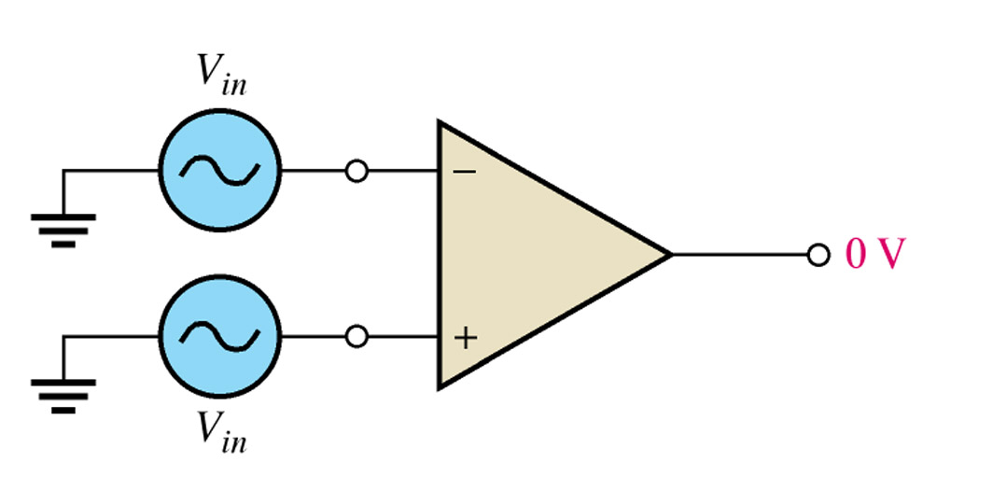
Op-Amp Input Modes
Common Mode Input
Two signals of same phase, frequency, and amplitude are applied to the inputs which results in no output (signals cancel). But, in practical, a small output signal will result.
This is called common-mode rejection. This type of mode is used for removal of unwanted noise signals.

Slide 14
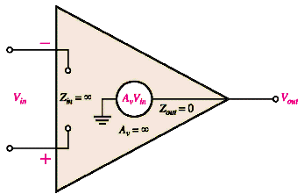
Ideal Op-Amp
Infinite Voltage Gain • Infinite Input Impedance • Zero Output Impedance
Voltage Controlled Voltage source (VCVS)

Slide 15
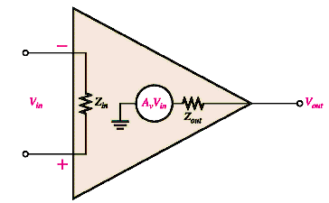
Practical Op-Amp

Slide 16
Ideal Vs Practical Op-Amp
 | _{Ideal} | _{Practical}
_{Open Loop gain A} | ∝ | ₁₀⁵
_{Bandwidth BW} | ∝ | _{10-100Hz}
_{Input Impedance Zin} | ∝ | _{>1MΩ}
_{Output Impedance Zout} | _{0 Ω} | _{10-100 Ω}
_{Output Voltage Vout} | _{Depends only on Vd} _{Differential mode signal} | Depends slightly on average input Vc = (V++V−)/2 Common-Mode signal
_{CMRR} | ∝ | _{10-100dB}

Slide 17
Ideal Op-Amp
Infinite Input Impedance
  Input impedance is measured across the input terminals.
  Input impedance is the ratio of input voltage to input current.
  When Z_{i} is infinite, the input current is zero.
  The op amp will neither supply current to a circuit nor will it accept current from any external circuit.
  In real op-amp, the impedance is 500 kΩ to 2MΩ

Slide 18
Ideal Op-Amp
Zero Output Impedance
Looking back into the output terminal, we see it as a voltage source with an internal resistance.
The internal resistance of the op-amp is the output impedance of op-amp.
  This internal resistance is in series with the load, reducing the output voltage available to the load
Real op-amps have output impedance in the range of 20-100 Ω .

Slide 19
Ideal Op-Amp
Infinite Open-Loop Gain
Open-Loop Gain, A is the gain of the op-amp without feedback.
In the ideal op-amp, A is infinite
In real op-amp, A is 20k to 200k

Slide 20
Ideal Op-Amp
Infinite Bandwidth
  The ideal op-amp will amplify all signals from DC to the highest AC frequencies
  In real op-amps, the bandwidth is rather limited
    This limitation is specified by the Gain-Bandwidth product, which is equal to the frequency where the amplifier gain becomes unity
    Some op-amps, such as 741 family, have very limited bandwidth, up to a few kHz only

Slide 21
Ideal Op-Amp
Zero Noise Contribution
  In an ideal op amp, all noise voltages produced are external to the op amp. Thus any noise in the output signal must have been in the input signal as well.
  The ideal op amp contributes nothing extra to the output noise.
  In real op-amp, there is noise due to the internal circuitry of the op-amp that contributes to the output noise

Slide 22
Ideal Op-Amp
Zero Output Offset
  The output offset voltage of any amplifier is the output voltage that exists when it should be zero.
  The voltage amplifier sees zero input voltage when both inputs are grounded. This connection should produce a zero output voltage.
  If the output is not zero then there is said to be an output voltage present.
  In the ideal op amp this offset voltage is zero volts, but in practical op amps the output offset voltage is nonzero (a few miliVolts).

Slide 23
Ideal Op-Amp
Both Differential Inputs Stick Together
  this means that a voltage applied to one inverting inputs also appears at the other non-inverting inputs.
  If we apply a voltage to the inverting input and then connect a voltmeter between the non-inverting input and the power supply common, then the voltmeter will read the same potential on non-inverting as on the inverting input.

Slide 24
7.1 Basic Differential Amplifier Analysis
7.1.1 DC Analysis of the Bipolar
Differential Amplifier Circuit

Slide 25
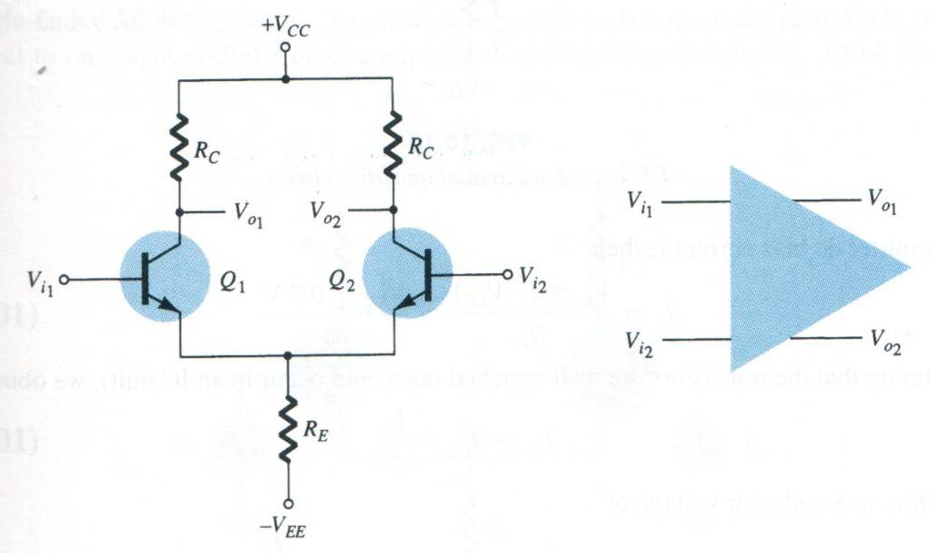
Dual Input Balanced Output Configuration

Slide 26
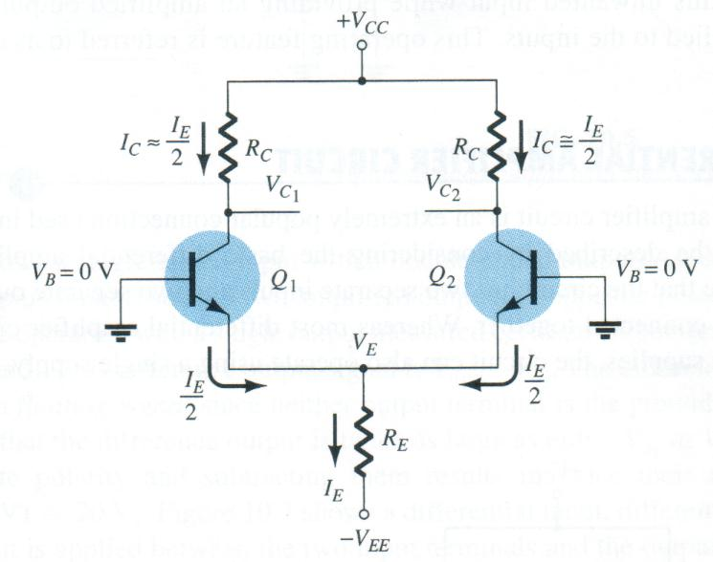
DC bias of differential amplifier circuit
DC ANALYSIS

Slide 27
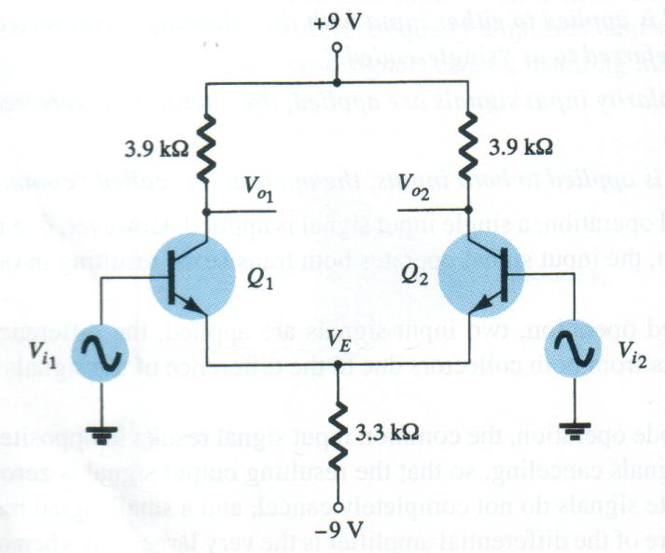
Example : Differential Amplifier Circuits
Calculate the dc voltages and currents

Slide 28
Operation
Example
Differential Amplifier Circuit
Solution

Slide 29
Four Possible Configurations
Dual Input, Balanced Output Configuration
Dual Input, Un-balanced Output Configuration
Single Input, Balanced Output Configuration
Single Input, Un-balanced Output Configuration

Slide 30
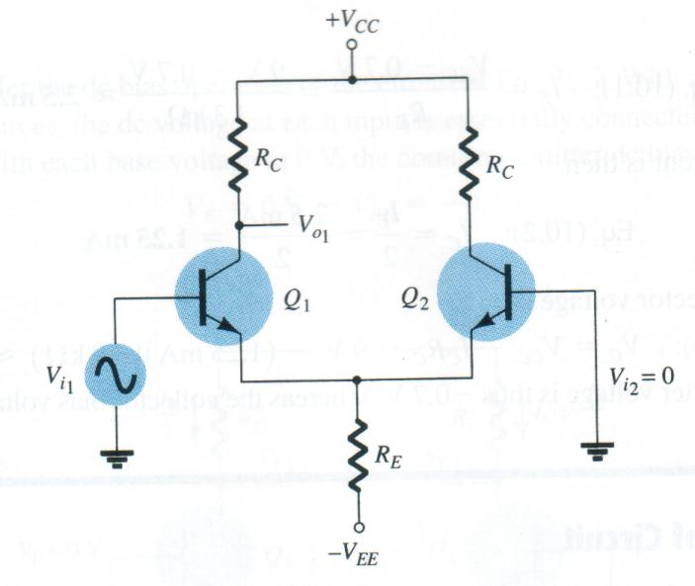
Differential Amplifier Circuit
AC ANALYSIS
Single-Ended
Connection to calculate : A_{v1} = V_{o1} / V_{i1}

Slide 31
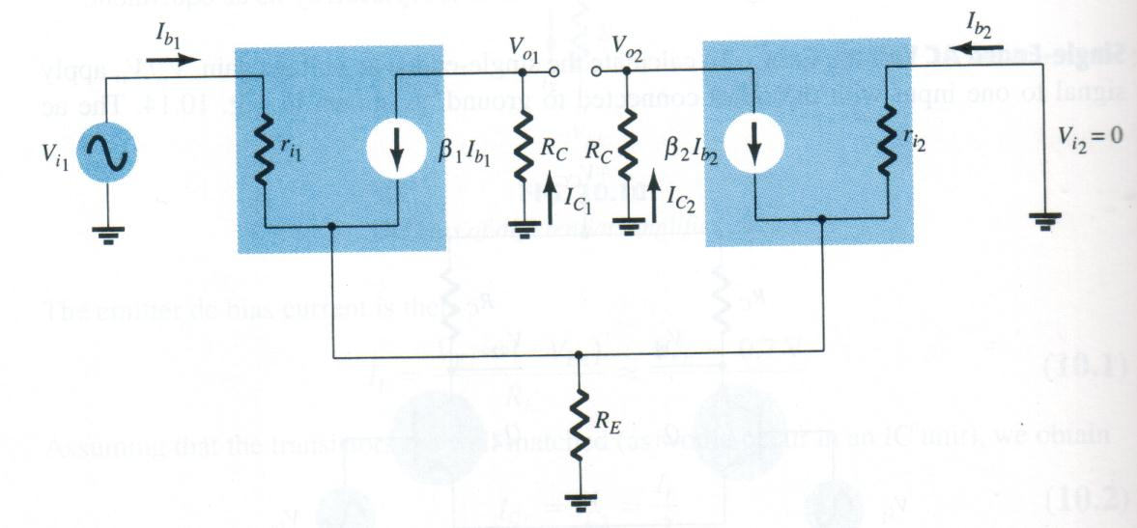
Single-Ended
Differential Amplifier Circuit
AC ANALYSIS
C
B
E
AC equivalent of differential amplifier circuit

Slide 32
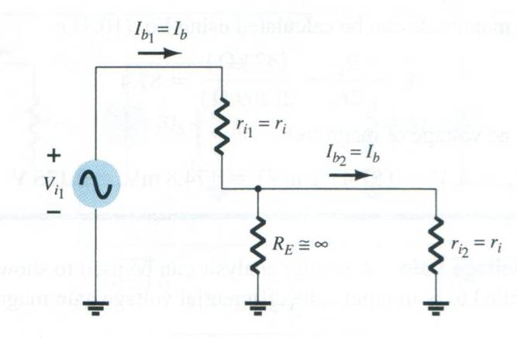
AC Analysis - Single ended
Differential Amplifier Circuit
KVL
Scan figure 10.11 & 10.15
Partial circuit for calculating I_{b}

Slide 33
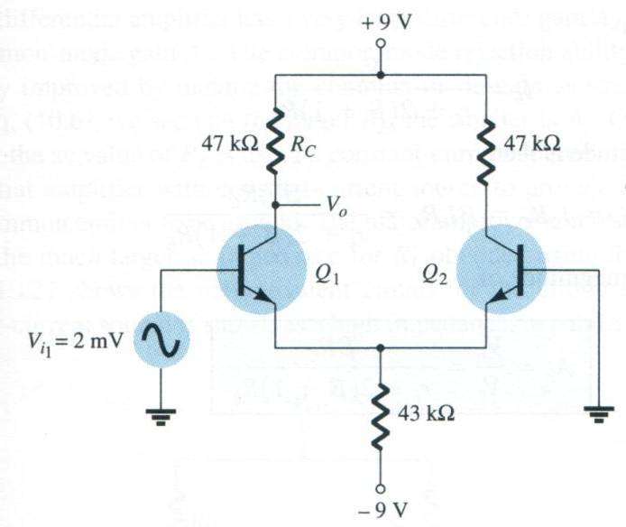
Example
Differential Amplifier Circuit
Solution
Calculate the single-ended output voltage V_{o1}

Slide 34
AC Analysis - Double ended
Differential Amplifier Circuit
A similar analysis can be used to show that for the condition of signals applied to both inputs, the differential voltage gain magnitude is

Slide 35
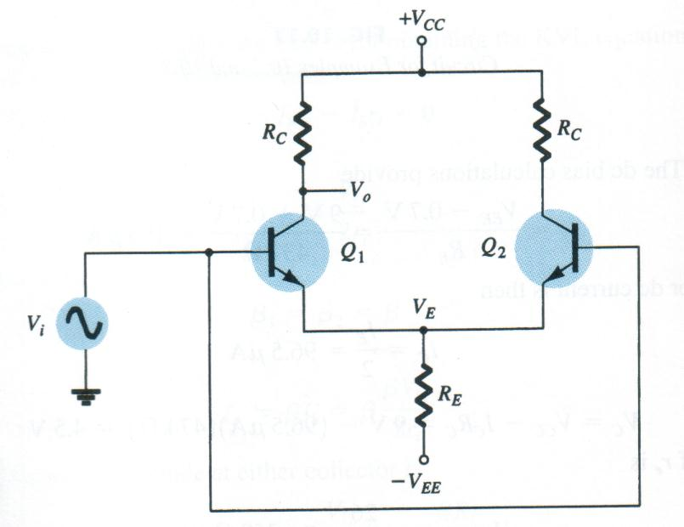
AC Analysis - Common-mode
Differential Amplifier Circuit
Common-mode connection

Slide 36
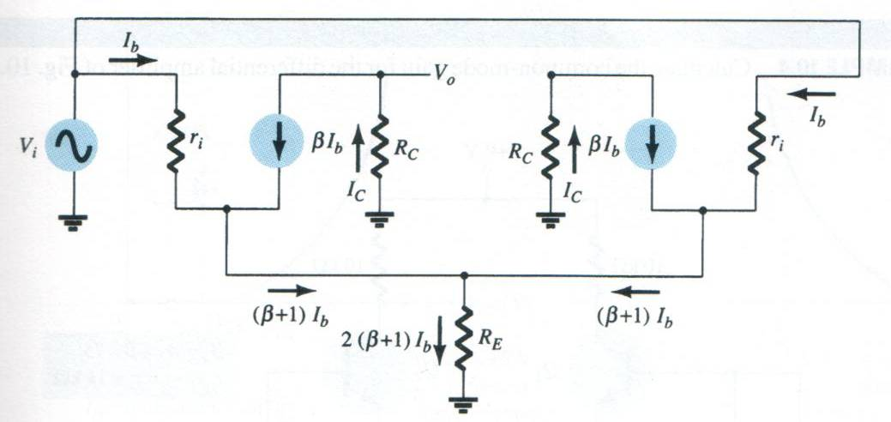
AC Analysis - Common-mode
Differential Amplifier Circuit

Slide 37
Distortion
The output voltage never excess the DC voltage supply of the Op-Amp

Slide 38
Common-Mode Operation
Same voltage source is applied
at both terminals
Ideally, two input are equally
amplified
Output voltage is ideally zero
due to differential voltage is
zero
Practically, a small output
signal can still be measured.
Note for differential circuits:
Opposite inputs : highly amplified
Common inputs : slightly amplified
⇒ Common-Mode Rejection

Slide 39
Common-Mode Rejection Ratio (CMRR)
Differential voltage input :
Common voltage input :
Common-mode rejection ratio:
Output voltage :
Note:
When G_{d} >> G_{c} or CMRR →∞
⇒V_{o} = G_{d}V_{d}
G_{d} : Differential gain
G_{c} : Common mode gain

Slide 40
CMRR Example
What is the CMRR?
Solution :
(1)
(2)
NB: This method is Not work! Why?

Slide 41
Applications of Op-Amp
To provide voltage amplitude changes (amplitude and polarity)
Comparators
Oscillators
Filters
Sensors
Instrumentation amplifiers

