Slide 1
Unit : 2
Bioassay of fermentation product
Biological assays include both assays in which compound being quantitated either depresses or stimulates the growth of a sensitive test organisms and those that employ enzymes.
- Bioassays are more difficult to perform, provide greater error and less reproducible than chemical & physical assays.
- Various types of m.o are employed.
- Bacteria are used for the assay of amino acids, antibiotics, and vitamins.

Slide 2
- Yeasts are used in vitamins and antibiotic assays.
- Fungi for vitamins, trace metals, antibiotics, and fungicidal and fungistatic materials.
- Protozoan – Euglena gracilis used in Vitamin B12 assay.
Requirements for a good test Organisms :
1. It should be genetically stable.
2. It should respond in a graded manner only to a test compound and not to the other materials.

Slide 3
3. should grow relatively quickly on a simple media.
4. should not be pathogen.
5. should grow in a fashion that facilitates reading the assay. i.e the cells should not clump in turbidimetric assays or swarm across the agar surface for diffusion assays.
6. Should be aerobic or facultative aerobe as anaerobic assays are difficult to perform and require special equipment.
7. Should grow well at a pH that does not affect the stability or toxicity of the material.

Slide 4
  Biological assays fall in to four groups :
  Diffusion Assays
  Turbidimetric and Growth Assays
  Metabolic Response Assays
  Enzymatic Assays
  Diffusion Assays :
  Diffusion assays are carried out on a solid
  Agar medium – suitable for the growth of the
  test organism.
  - Compound to assayed is allowed to diffuse
  through the medium in a radial fashion

Slide 5
from a cup so that the growth of the test organism is either depressed with antibiotic or stimulated with a growth factor (vitamins).
- diameter of this area reflects the concentration of the compound being assayed and is compared with similar zones produced by known concentrations of standard compound.

Slide 6
There are Two types of Diffusion assays :
- Cylinder method : antibiotic solution or other fermentation product diffuses from a reservoir or Cylinder in to the surrounding agar.
- Paper Disc method : Defined amount of fermentation solution(0.1ml) is applied to the disc.

Slide 7
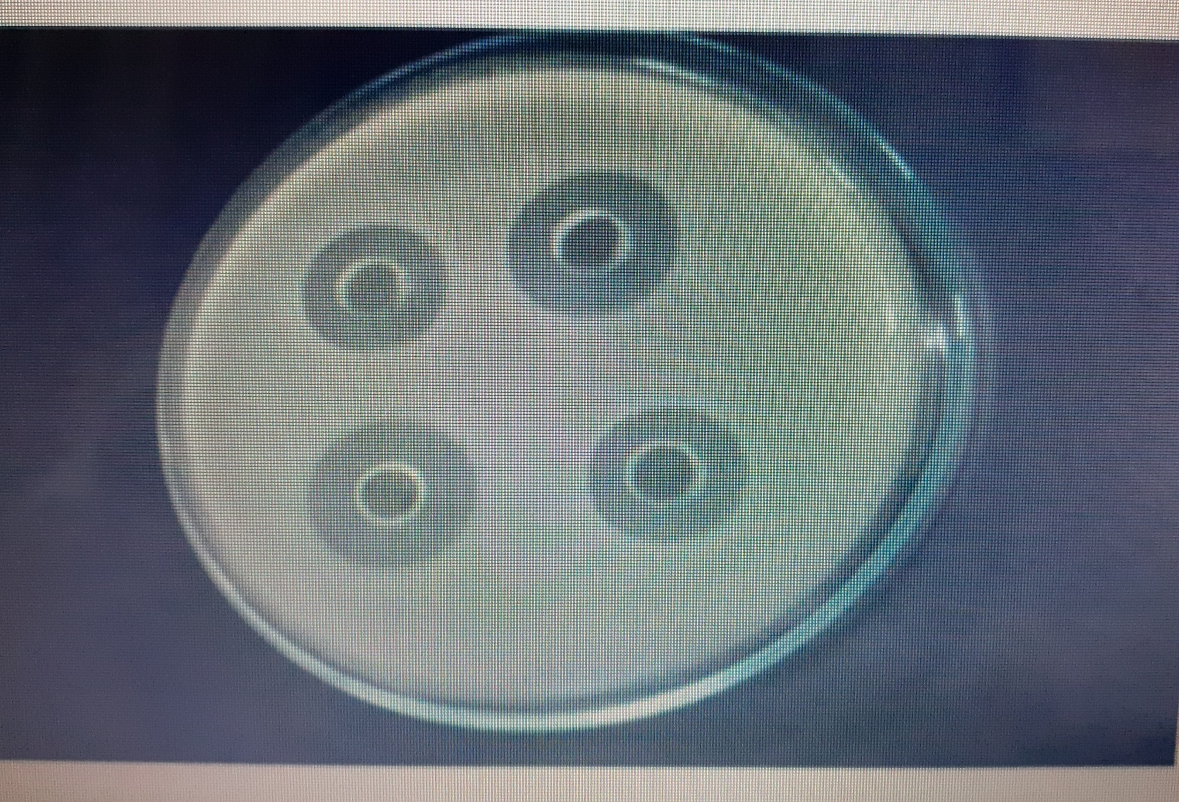

Slide 8
Turbidimetric and Growth Assays :
  - The effect of the compound under test in liquid culture is measured as increased or decreased turbidity associated with the growth rate or total growth of M.O.
  - Series of tubes with a suitable liquid medium are added with material to be assayed in a graded amount.
  - Tubes are inoculated with test organism, and incubated.
  - Reading are taken as O.D or absorbance.
  - The O.D is plotted against the conc. of Standard to obtain a standard curve.

Slide 9
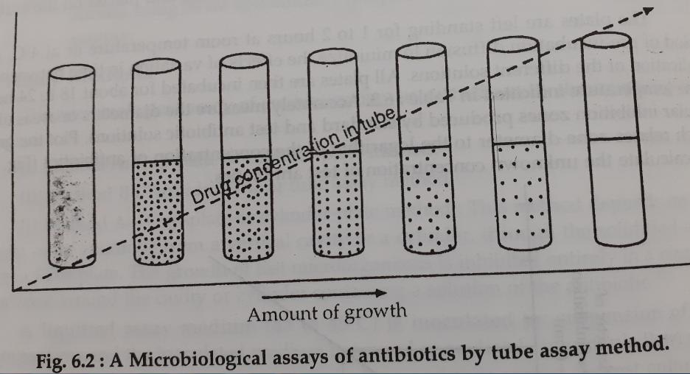

Slide 10
End point determination assays :
- End point assay is employed when the Microbial growth occurs as a pellicle on the surface of the medium or cells clump at bottom.
- series of tubes of growth medium containing serially diluted compound( e.g Antibiotic) , is inoculated with test organism and incubated.
- each tube is observed to determine the presence or absence of growth.

Slide 11
- The last tube that does not show growth in the dilution series is equivalent to a dilution of the compound/ fermentation broth.
e.g if the last dilution is 1/64, then approximately 64 dilution units /ml of the compound present.
- Dilution units are of value when the fermentation product is newly discovered and the standard reference is not available.

Slide 12
Metabolic Response assays :
- Similar to turbidimetric assays, except that, instead of measuring the effect of the product on the growth of test organism, we measure its effect on some metabolic reaction during growth.
- e.g Acid production, CO2 evolution, O2 absorption and Enzyme dehydrogenase activity.

Slide 13
Enzymatic Assays :
- Enzymatic assays are highly specific and will quantitatively detect minute amounts of a fermentation product as well as differentiate between biologically active and inactive forms of compound.
- Enzyme preparation is incubated with a sample of culture broth so as to cause some enzyme mediated change in the fermentation product such as partial decomposition with formation of measurable product.

Slide 14
- e.g. L- Glutamic acid in a sample of fermentation broth can be assayed by adding washed cells of E.coli contain the enzyme glutamic acid decarboxylase. Toluene is added to this mixture to liberate the enzyme from the cells and the assay is carried out at pH-5.
- One mole of CO2 is liberated from each mole of glutamic acid.
- The CO2 is poorly soluble in water at this pH, is evolved to the atmosphere as the gas and measured by manometric means with a Warburg Respirometer.

