Slide 1
FYBSc English
Topic 2
Describing

Slide 2
It is necessary for students to learn how to use English for describing places, people and objects, etc.
They have to equip themselves with the knowledge and use of English structures and vocabulary to be able to meet the requirement of the job market, after their graduation.
They may take up a job of a salesman, tourist guide, or they may even like to take up journalism as their career.
Whatever field they choose, they will need English for their efficient functioning in that field. This unit and the following ones also have been written with this objective in mind

Slide 3
If you are asked to describe a photo or a picture in the exam, here is some language you can use
Example: Picture of a kitchen
This is a kitchen platform. Above it, there is a small cupboard in which there are kettle and pans. On the platform, there is a gas-stove as well as a microwave unit. Near the microwave, there is a sink with water-taps. Below the kitchen platform, there are a number of cupboards to keep big and small dishes, pots, etc.

Slide 4
Before you describe any picture, look at it carefully and answer these questions:
1) Where do you think this is?
2) Who do you think the people are? What can you say about their age, appearance, mood etc?
3) What are the people doing? Use Present continuous Tense.

Slide 5
What is in the picture?
In the picture I can see ...
There is /
There are ...
There isn’t a ... /
There aren’t any ...
This is a picture of

Slide 6
Say what is happening with the present continuous
Say what is happening or what people are doing
The man is ...ing
The people are ...ing
It’s raining.

Slide 7
What is where in the picture?
At the top/bottom of the picture ...
In the middle of the picture ...
On the left/right of the picture ...
next to
in front of
behind
near
on top of
under

Slide 8
If something isn’t clear
It looks like a ...
It might be a ...
He could be ...ing
Perhaps it’s a ...

Slide 9
What I think about the picture
It seems as if ...
The person/man/boy/ woman/ girl seems to ...
Maybe ...
I think ...
... might be a symbol of ...
The atmosphere is peaceful/depressing ...
I (don't) like the picture because ...
It makes me think of ...

Slide 10
Describing Objects
D
 | shape | colour | material
briefcase | rectangular | black | leather
Coca-Cola bottle | cylindrical | transperant | Glass/plastic
iPhone | flat rectangular | grey | metal, glass
pencil | cylindrical | yellow | wood
envelope | flat square | white | paper
DVD | flat round | silver | plastic

Slide 11
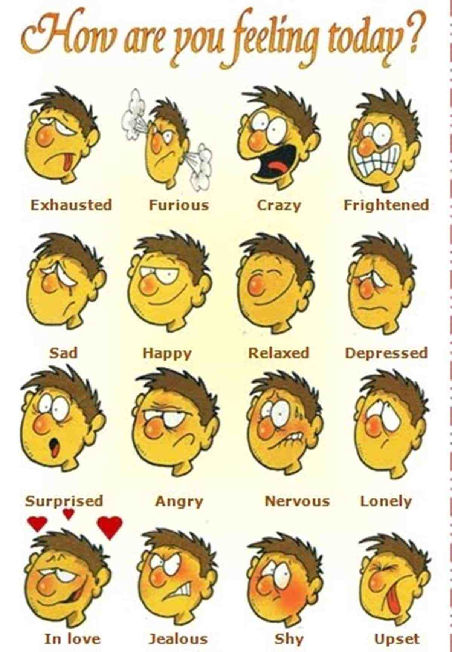
Describing how people’s face looks

Slide 12
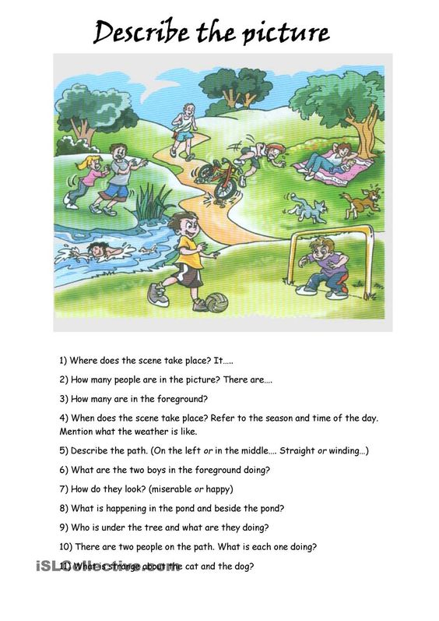

Slide 13
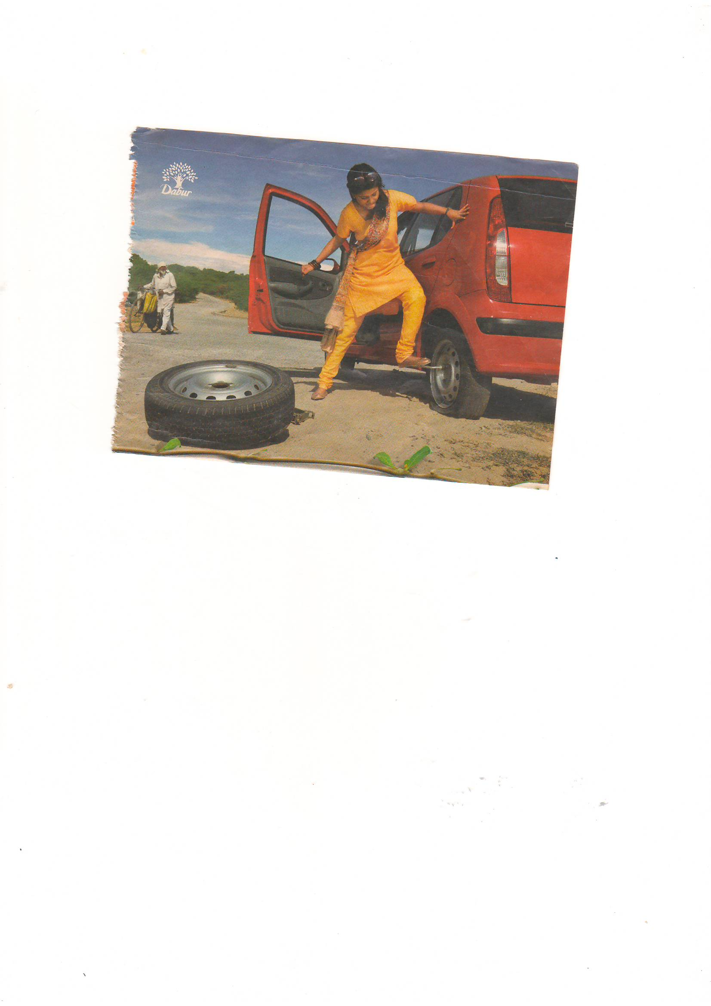

Slide 14
Describing Someone’s Appearance
. Appearance is defined as the way someone or something looks.
beautiful (My younger sister is very beautiful.)
handsome (He’s the most handsome man I’ve ever met.)
cute (That’s a cute little baby.)
thin (She was looking pale and thin.)
tall (She’s tall and thin.)
chubby (She was eleven years old and pretty in a chubby sort of way.)
muscular (He was tall, lean and muscular.)
attractive (The actress is an attractive woman.)
Shappy ( not well dressed, hair not done , ill fitting clothes etc)

Slide 15
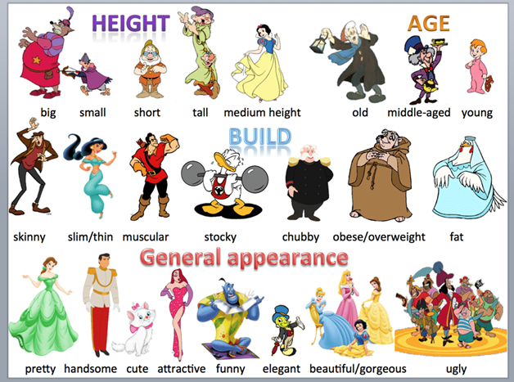

Slide 16
