Slide 1
Fermentation and Substrate level Phosphorylation :
- Fermentation is the simplest mode of ATP generating metabolism.
- Metabolic process in which organic compounds serve both as ē donor and ē acceptor.
- ē are not passed through ETC.
- ē are passed to an oxidized pyridine nucleotide – reducing it. Then donates ē directly to ē acceptor.

Slide 2
- organic compounds that serve both as ē donor and ē acceptor are usually two different metabolites derived from a single substrate.
- Fermentation often gives rise to a mixture of end products– some may be more reduced and some may be more oxidized than the primary substrate.
- Carbohydrates are the principle substrate of fermentation.

Slide 3
- ATP is formed from ADP & Pi from phosphorylated intermediate arise during substrate breakdown – is only possible with fermentation is known as substrate level phosphorylation.
- Organisms that obtain energy by fermentation are strict anaerobes.
- Pyridine nucleotides reduced in one step of fermentation are oxidized in another.
- Two molecules of NAD⁺ reduced are reoxidized by reactions involving the subsequent metabolism of pyruvic acid.
Fig :

Slide 5
Photosynthesis & Photophosphorylation
Photosynthesis is the process by which plants & certain bacteria (Phototrophs) converts radiant (light) energy in to metabolic energy & reducing power.
Photosynthetic structure in plant – Chloroplast. In bacteria- chromatophore.
General equation for photosynthesis :
CO2 + H2O → O2 + (CH2O)
In plants it is H2O , in bacteria – H2S or organic compounds.

Slide 6
Different types of reactions in Bacterial Photosynthesis:
Purple Sulphur Bacteria e.g. Chromatium utilize H2S.
2H2S + CO2 → C(H2O) + 2S + H2O
Purple Sulphur Bacteria utilize Thiosulphate as reductant.
2CO2 + Na2S2O3 + 5H2O → 2C(H2O) + 2H2O + 2NaHSO4
- Non sulphur bacteria e.g.- Rhodosprillum rubrum utilizes organic compounds like ethanol, isopropanol or succinate.
CO2 + 3 C2H5OH → 2C(H2O) + H2O + CH3CHO
- Purple and green sulphur bacteria carry out anoxygenic photosynthesis.

Slide 7
Photosynthetic Appratus –
Consist of Three components:
1. An antenna of light harvesting pigments.
2. A photosynthetic Reaction Centre
3. ETC
I. An antenna of light harvesting pigments :
Light harvesting pigments include : Chlorophylls, Carotenoids, Phycobiliproteins.

Slide 8
- Chlorophylls- Plays two roles in photosynthesis - as a light harvesting pigment and as light harvesting pigment.
- Carotenoids & Phycobiliproteins function only as light harvesting pigment.
Chlorophylls :
- Seven kinds occur in various groups of Phototroph.
- Absorb light intensity in two regions – Violet around 400 nm and red or infrared around 600 to 1000nm.
- Resemble hemes.

Slide 9
- Contain four pyrrole ring which are linked to gather by methane bridge.
- In bacteria - chlorophylls are Bacteriochlorophylls - a, b, c, & d. Also contain small amounts of Pheophytins or Bacteriopheophytins(BChl that lack Mg⁺).
- play a special role as ē carriers.

Slide 10
Carotenoids :
- Found in almost all photosynthetic organisms.
- Yellow and orange pigment- soluble inorganic solvents.
- Two types – Carotenes & Carotenols.
Carotenes – e.g. β – carotene , are hydrocarbon.
- present in photosystem- I.
Carotenols (Xanthophylls) are alcohols. Present in photosystem – II.
- Carotenods have single region of absorption between 450 & 550 nm.

Slide 11
Phycobiliproteins :
- are water soluble chromoproteins, contain tetrapyrrols.
- Region of absorption is between 550 & 650 nm.
- two kinds – Phycocyanins (predominate in Blue Green Bacteria)& Phycoerythrins(Red algae).
II. Photochemical Reaction Center :
- contains the site where a molecule of chlorophyll becomes photoactivated & oxidized by donating ē to a carrier molecule.

Slide 12
- Chlorophyll molecule of reaction center differ from antenna – (1) They are associated with certain proteins which on interaction decreases the energy required for activation.
(2) They are in close proximity with carrier molecule which accept ē from them when activated.
- Energy required to activate a molecule of chlorophyll is designated as P (pigment) in reaction center, by a maximum wavelength of photon.

Slide 13
e.g. the reaction center of purple bacterium that is activated maximally by photons of wavelength 870 nm is designated P870.
Reaction center of Purple bacterium- Rhodobacter sphaeroides , -- contains three polypeptide chain, four bacterioChl. , two bacteriopheophytin , two ubiquinone and one iron molecule.
- Rhodopseudomonas viridis also contains cytochrome subunit with four C –type hemes.

Slide 14
III. Photosynthetic ETC :
Photosynthetic ETC located within Photosynthetic membrane – composed of carrier molecules - cytochromes, quinones and Iron sulfur centers.
- Electron flows through ETC – a proton motive force is generated- used to synthesize ATP by a membrane located ATPsynthase.
ETC :
Hemes in cytochrome subunit of RC → P870 → BChl → ↑ → BP → QA → QB → Cyt- bc1 → Cyt- C2 →
↑ ----------←-----------←-----------←---------- ←---------←------←---------↓

Slide 15
Photophosphorylation :
- Photosynthetic bacteria have relatively simple phototransduction machinery, with one of two general types of reaction center.
- One type (found in purple bacteria) passes electrons through pheophytin (chlorophyll lacking the central Mg2 ion) to a quinone.
- The other (in green sulfur bacteria) passes electrons through a quinone to an iron-sulfur center.

Slide 16
- The photosynthetic machinery in purple bacteria
consists of three basic modules (Fig. ) : a single reaction center (P870), a cytochrome bc1 electron transfer complex , and an ATP synthase, similar to that of mitochondria.

Slide 18
A pair of bacteriochlorophylls— designated (Chl)2—is the site of the initial photochemistry in the bacterial reaction center.
- Energy from a photon absorbed by one of the many antenna chlorophyll molecules surrounding the reaction center reaches (Chl)2 by exciton transfer.
- the energy of the photon, converting the special pair to a very strong electron donor.

Slide 19
- The (Chl)2 donates an electron that passes through a neighboring chlorophyll monomer to pheophytin (Pheo).
(Chl)2 + 1 exciton → (Chl)2* (excitation)
(Chl)2* + Pheo → (Chl)2 + Pheo⁻ (charge separation)
- The pheophytin radical now passes its electron to a tightly bound molecule of quinone (QA), converting it to a semiquinone radical

Slide 20
- which immediately donates its extra electron to a second, loosely bound quinone (QB) convert QB to its fully reduced form, QBH2.
2 Pheo⁻ + 2H⁺ + QB → 2 Pheo + QBH2 (quinone reduction)
- The hydroquinone (QBH2), carrying some of the energy of the photons that excited P870, enters the pool of reduced quinone (QH2) to cytochrome bc1 complex.

Slide 21
- cytochrome bc1 complex using the energy of electron transfer to pump protons across the membrane, producing a protonmotive force.
- Electrons move from the cytochrome bc1 complex to P870 via a soluble cytochrome -c2.
- The electron transfer process completes the cycle, returning the reaction center to its unbleached state, ready to absorb another exciton from antenna chlorophyll.

Slide 22
Photosynthesis in green sulfur bacteria involves the same three modules as in purple bacteria.
- The process differs with respects to additional enzymatic reactions (Fig).
- Excitation causes an electron to move from the reaction center to the cytochrome bc1 complex via a quinone carrier.
- Electron transfer through this complex powers proton transport
and creates the proton-motive force used for ATP synthesis, just as in purple bacteria.

Slide 23
- in contrast to the cyclic flow of electrons , some electrons flow from the reaction center to an iron-sulfur protein, ferredoxin, which then passes electrons via ferredoxin:NAD reductase to NAD, producing NADH.
- The electrons taken from the reaction center to reduce NAD are replaced by the oxidation of H2S to elemental S, then to SO4, in the reaction that defines the green sulfur bacteria.

Slide 24
ATP : Structure, Generation & Role :-
- ATP was discovered in muscle extracts by C.Fiske & Y. Subbarow in USA and independently by K. Lohmann in Germany in 1929.
- The structure of ATP was first deduced by K. Lohmann in 1930.

Slide 25
- Derivative of nucleotide Adenosine Mono Phosphate (AMP) or Adenylic acid, to which two additional phosphate groups are linked through pyrophosphate bonds.
- these two bonds are energy rich and their removal by hydrolysis yield ADP & AMP- liberates energy by the transfer of one or both terminal phosphate groups.

Slide 26
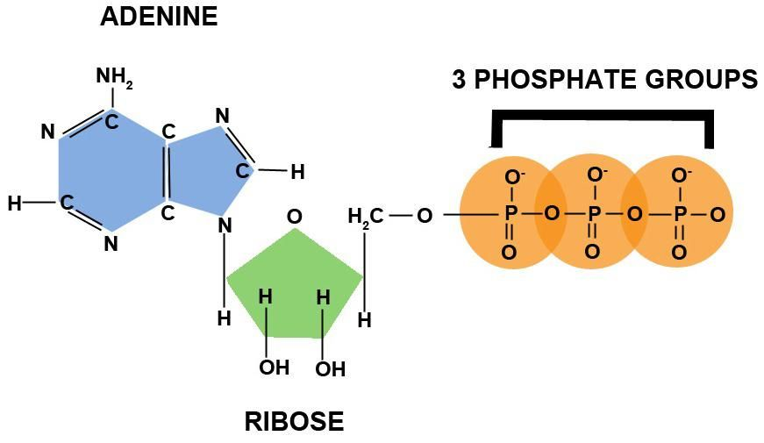
ATP : (Structure, generation & role)
-

Slide 27
e.g. Activation of Glucose :
Glucose + ATP → Glucose-6-P + ADP Activation of Amino acids :
Amino acid + ATP → AMP- Amino acid + P - P
- AMP is converted to ADP through energy transfer by enzymatic reaction-
AMP + ATP → 2 ADP
- Carrier of free energy is ATP – plays a central role in the transfer of free energy from exergonic to the endergonic (energy requiring) processes in the cell.

Slide 28
Generation of ATP :
Three Mechanisms :
1. Oxidative Phosphorylation
2. Substrate level Phosphorylation
3. PhotoPhosphorylation
Role of ATP :
- Fritz Lipmann- 1941 postulated that - ATP functions in a cyclic manner from degradative reactions which yield energy to the various cellular processes that require energy.

Slide 29
- Drive the entry of nutrients into the cell.
- To convert these nutrients into intermediary metabolites.
e.g. amino acids, sugar- P ,nucleotides, fatty acids.
- Polymerization of intermediates into biopolymers like Proteins, Polysaccharides, N. acids & lipids.

