Slide 1
Fermentation Technology
Also known as Industrial Microbiology or Microbial biotechnology.important branch of Microbiology where economically valuable products are produced from cheaper raw materials by using large culture of m.o.

Slide 2
Up stream and Downstream process.
Screening-Definition.
Primary screening of:
Organic acid producers-Use of phenol red dextrose agar and caco3
Amylase producers-Starch agar
Antibiotic producers-Crowded plate method.
Vitamin and growth factor producers-Auxanography.

Slide 3
Concept of fermentation technology.
Originally the term fermentation derived from latin word fervere means to boil.so it refers to bubbling observed when sugary or starchy materials undergo transformation to yield alcohol by yeast.the bubbling is due to production of CO2.
Later the term fermentation was applied to the process of producing alcohol from sugar irrespective of whether the causative agent was biological or not.
Pasteur defined fermentation to any anaerobic process through which m.o.obtain energy for growth.
Today,fermentation i s applied to both aerobic and anaerobic metabolic activities of m.o.in which specific chemical changes are brought about in any organic substrate.
Fermentation technology is important branch of Microbiology,where economically valuable products are produced from cheaper raw materials by using mass culture of m.o.

Slide 4
Screening can be defined as the use of highly selective procedure,used for detection and isolation of only those organisms of interest from among a large microbial population.

Slide 5
Crowded plate method
It s used for detecting and isolating antibiotic producers.
The method consists of preparing series of dilutions of soil sample,followed by spreading of dilutions on nutrient agar plates,so that 300 or 400 colonies are obtained.
The ability of a colony to show antibiotic activity is indicated by presence of zone of growth inhibition surrounding the colony.such a colony is then subcultured to a fresh medium.
The major problem is that the method provides information against the unwanted microbes that may be present by chance.

Slide 6
Therefore the method is modified by introducing test culture.
In this method,agar plates which give100 to200 well isolated colonies after incubation are flooded with suspension of test organsm.
The plates are then further incubated to allow the growth of test org.
The formation of inhibitory zones around certain colonies indicates their antibiotic activity.
The diameter of zones of inhibition are measured to obtain a rough estimation of relative amount of antibiotic produced by various colonies
.The colonies of antibiotic producers finally isolated & purified.

Slide 7
Auxanography.
Preparation of first plate:
Filter paper strip is put across the bottom of petri dish so that two ends pass over the edge of the dish.
A filter paper disc of petri dish sze s placed over paper strip on the bottom of the dish.
Melted nutrient agar is poured on paper disc &allowed to solidify.
Soil after dilution,is spreaded to produce well isolated colonies.

Slide 8
Preparation of second plate.
A minimal medium lacking growth factors is inoculated with the test org.
The inoculated medium is poured on the surface of fresh petridish.
The plate is allowed to solidify.

Slide 9
The agar in the first plate is carefully and aseptically lifted out with spatula and placed,without inverting on the surface of second plate.
The colonies which have produced growth factors will diffuse and come in contact with the test organism which now get the growth factors and will produce the colonies.

Slide 10
Significance of secondary screening.
Useful in sorting out m.o.which have a real commercial value from many isolates obtained during primary screening.at the same time,m.o.which have poor application are discarded since their studies involve much labour and expenses.
Provides information whether the product produced by m.o.is a new one or not.this is done by paper,thin layer or other chromatography methods.
Gives an idea about economic position of fermentation process involving a newly discovered culture.Thus one should have a comparative study of this process with processes already known.
Helps in providing information regarding product yield potential of different isolates.so it is useful in selecting efficient cultures.

Slide 11
5) It determines optimum conditions for growth or accumulation of product associated with culture.
6) Provides information about effect of different components of medium.This is valuable n designing the medium economic point of view.
7) It detects gross genetic instability of microbial cultures because m.o.usually undergo mutation and lose their capacity for maximum accumulation of product.
8) Gives information about number of products produced in a single fermentation additional products can be sold as byproducts.

Slide 12
9 Gives information about solubility of product in various organic solvents.it is useful in recovery and purification of the product.
10)Chemical,physical and biological properties of the product are also determined.
11) It shows whether the culture is homofermentative or heterofermentative.
12) With certain types of products like antibiotics,determination of toxicity for animal,plant or humans are made if they are to be used for therapeutic purpose
13) It tells something about chemical stability of fermentation product.

Slide 13
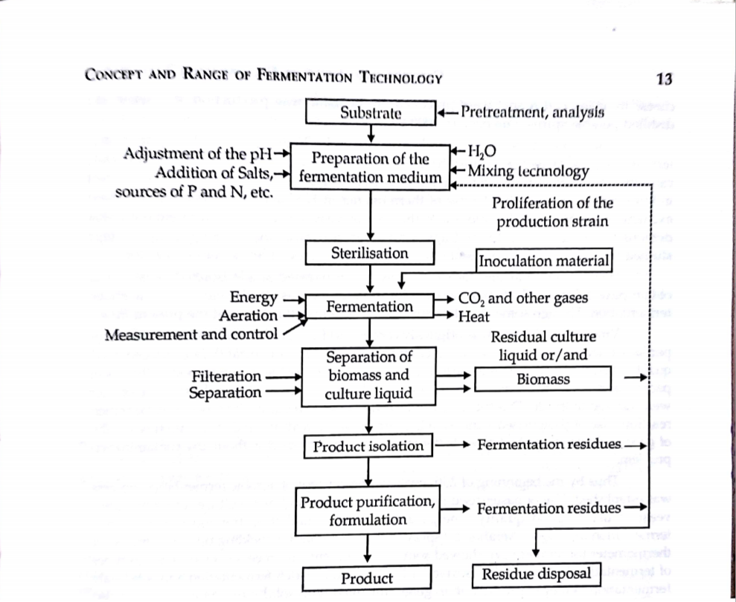
The Fermentation Process Outline

Slide 14
1)The formulation of medium to be used to grow the org.during development of inoculum and in production fermenter.
2)The sterilization of medium, fermenter and other equipments.
3)Inoculate sufficient quantity of pure culture in production vessel.
4)Growth of organism n fermenter under optimum conditions for product formation.
5)The extraction of product and its purification.
6)The disposal of effluents produced by the process.

Slide 15
Range of fermentation products.
Classified into foll.major groups.
Those which produce microbial cells as product i.e. microbial biomass.
Those which produce microbial metabolites i.e.primary&secondary.
Those that produce microbial enzymes.
Those that modify a compd.which then added to fermentation i.e. biotransformation products.
Those which produce recombinant products.
Food industry products i.e.fermented foods.
Elicitors-induced products.

Slide 16
1)Microbial biomass involves production of microbial cells as major fermentation end products &has 2 major applications.
Production of yeast to be used in baking industry and
Production of microbial cells to be used as human or animal food i.e.SCP
Production of baker’s yeast involves large scale production of Saccharomyces cerevisiae on molasses medium and has been used as a protein supplement for humans and animals.
Similarly Candida utilis cultivated on sulfite waste liquor from paper pulp industry is used as SCP for humans and animals.
b)Microbial inoculants:
Used in a variety of food applications and result into changes in food properties like texture,flavour etc.
Also used as insecticidal bacteria for plant disease control,legume inoculants for use as biofertilizer & methanogens for use in waste treatment processes.also in prophylactic treatment for diseases.

Slide 17
2) Microbial metabolites.-The growth of a microbial culture can be divided into no. of stages-introduction about four phases.
> Apart from growth pattern,behaviour of culture can also be described acc. to products,which it produces during various stages of growth curve.
Primary: During log phase of the growth,products produced are essential to the growth of the cells and include amino acids,proteins,nucleotides,lipids,carbohydrates etc.these products are called primary metabolites and the phase in which they are produced is also called as trophophase.
Many products of primary metabolism are of economic importance and are produced by fermentation.the synthesis of primary metabolites by wild type org.is sufficient for the requirements of org.so it i s the work of industrial microbiologist to modify this wild type org.and to provide cultural conditions to improve productivity of these compds.

Slide 18
B) Secondary- During stationary phase,some microbial cultures synthesize compds.which are not produced during trophophase and which do not have any obvious function in cell metabolism.such compds.are known as secondary metabolites and the phase in which they are produced is called idiophase.
Secondary metabolism is a property of a slow growing cells and m.o.grow at a relatively low growth rates in natural envt.means idiophase state occurs in nature
Secondary metabolites are released from intermediates and products of primary metabolism All m.o.do not undergo secondary metabolism.It is common in filamentous bacteria,fungi and sporing bacteria but not found in for e.g. Enterobactereaceae.
Importance of secondary metabolites to industry is the effects they have on org.other than those that produce them.Many secondary metabolites have antimicrobial activity,some are enzyme inhibitors,some are growth promoters and many have pharmacological properties.
wild type org.produce only low conc.of secondary metabolites because their synthesis is controlled by catabolite repression and feed back systems.

Slide 19
3) Microbial enzymes: they are produced commercially from plant,animal and microbial sources.Microbal enzymes have several advantages:(i) They can be produced in large quantities by fermentation tech.(ii) it is easier to improve productivity of a microbial system compared to plant or animal.(iii) The discovery of recombinant DNA technology has helped enzymes of animal origin to be synthesized by m.o.
Majorty of applications are in food and related industries. However,enzyme production is closely controlled in m.o.and so to improve productivity,these controls may have to be modified for e.g. by including inducers in the medium.
Examples:Alkaline protease in detergent industry,Streptokinase for dissolving blood clots,Amylase and glucose isomerase for preparation of HFCS i.e.high fructose corn syrup which is used in place of sucrose in preparation of alcoholic beverages and soft drinks.
Many intracellular enzymes like restriction endonuclease,ligase etc. have application in genetic engineering.

Slide 20
4) Biotransformation products: Microbial cells can be used to convert a compound into structurally related but financially more valuable compd.Microbial enz. Catalyze various reactions such as oxidation,dehydrogenation,hydroxylation,dehydration,condensation,isomerization,amination,deamination,carboxylation etc.
Microbial transformation processes have adv.over chemical processes.
i)They have high degree of specificity (ii) It requires low temperature.
The production of Vinegar is the most well established biotransformation product(conversion of ethanol to acetic acid.by Acetobacter aceti)
Steroid drug cortisone requires 37 reactions for chemical synthesis but a strain of Rhizopus arrhizus could hydroxylate progesterone and synthesize cortisone in 11 steps and thus reduces the cost of production.
The only disadvantage is that for microbial transformation to occur,large biomass culture of microbial spp. Is required to catalyze a single reaction. This can be modified by use of immobilization methods.

Slide 21
5) Recombinant products: Recombinant DNA technology extended the range of potential fermentation products.Now,genes from higher org.can be introduced into microbial cells so that microbial cells are capable of synthesizing foreign proteins.
Microbial cells which can be used as host include E.coli,Saccha.cere.and filamentous fungi.
Products produced by such genetically engineered org.include interferon,insulin,human serum albumin,calf chymosin and bovine somatostatin.
Important factors to design these processes include secretion of product as well as maximizing the expression of foreign gene.

Slide 22
6) Food industry products i.e. fermented foods: wide range of products of food industry such as sour cream,yoghurt,cheeses,fermented meat,bread,alcoholic beverages,vinegar etc.are produced through microbial fermentation process the efficiency of strain used and processes used are continuously improved at a more reasonable cost.
7)Elicitors-induced products: It is possible to induce or increase production of a compound in culture by using elicitors which may be m.o.For e.g.sacch.cere.is an efficient elicitor in producton of glyceollin and berberin.The production of morphine and codeine was increased 18 times by Verticillium spp.

