Slide 1
Methods of Immobilization of microbial cells :
The methods for cell immobilization include :
1. Adsorption
2. Covalent Bonding
3. Cross-linking
4. Copolymerization
5. Entrapment
6. Micro-encapsulation

Slide 2
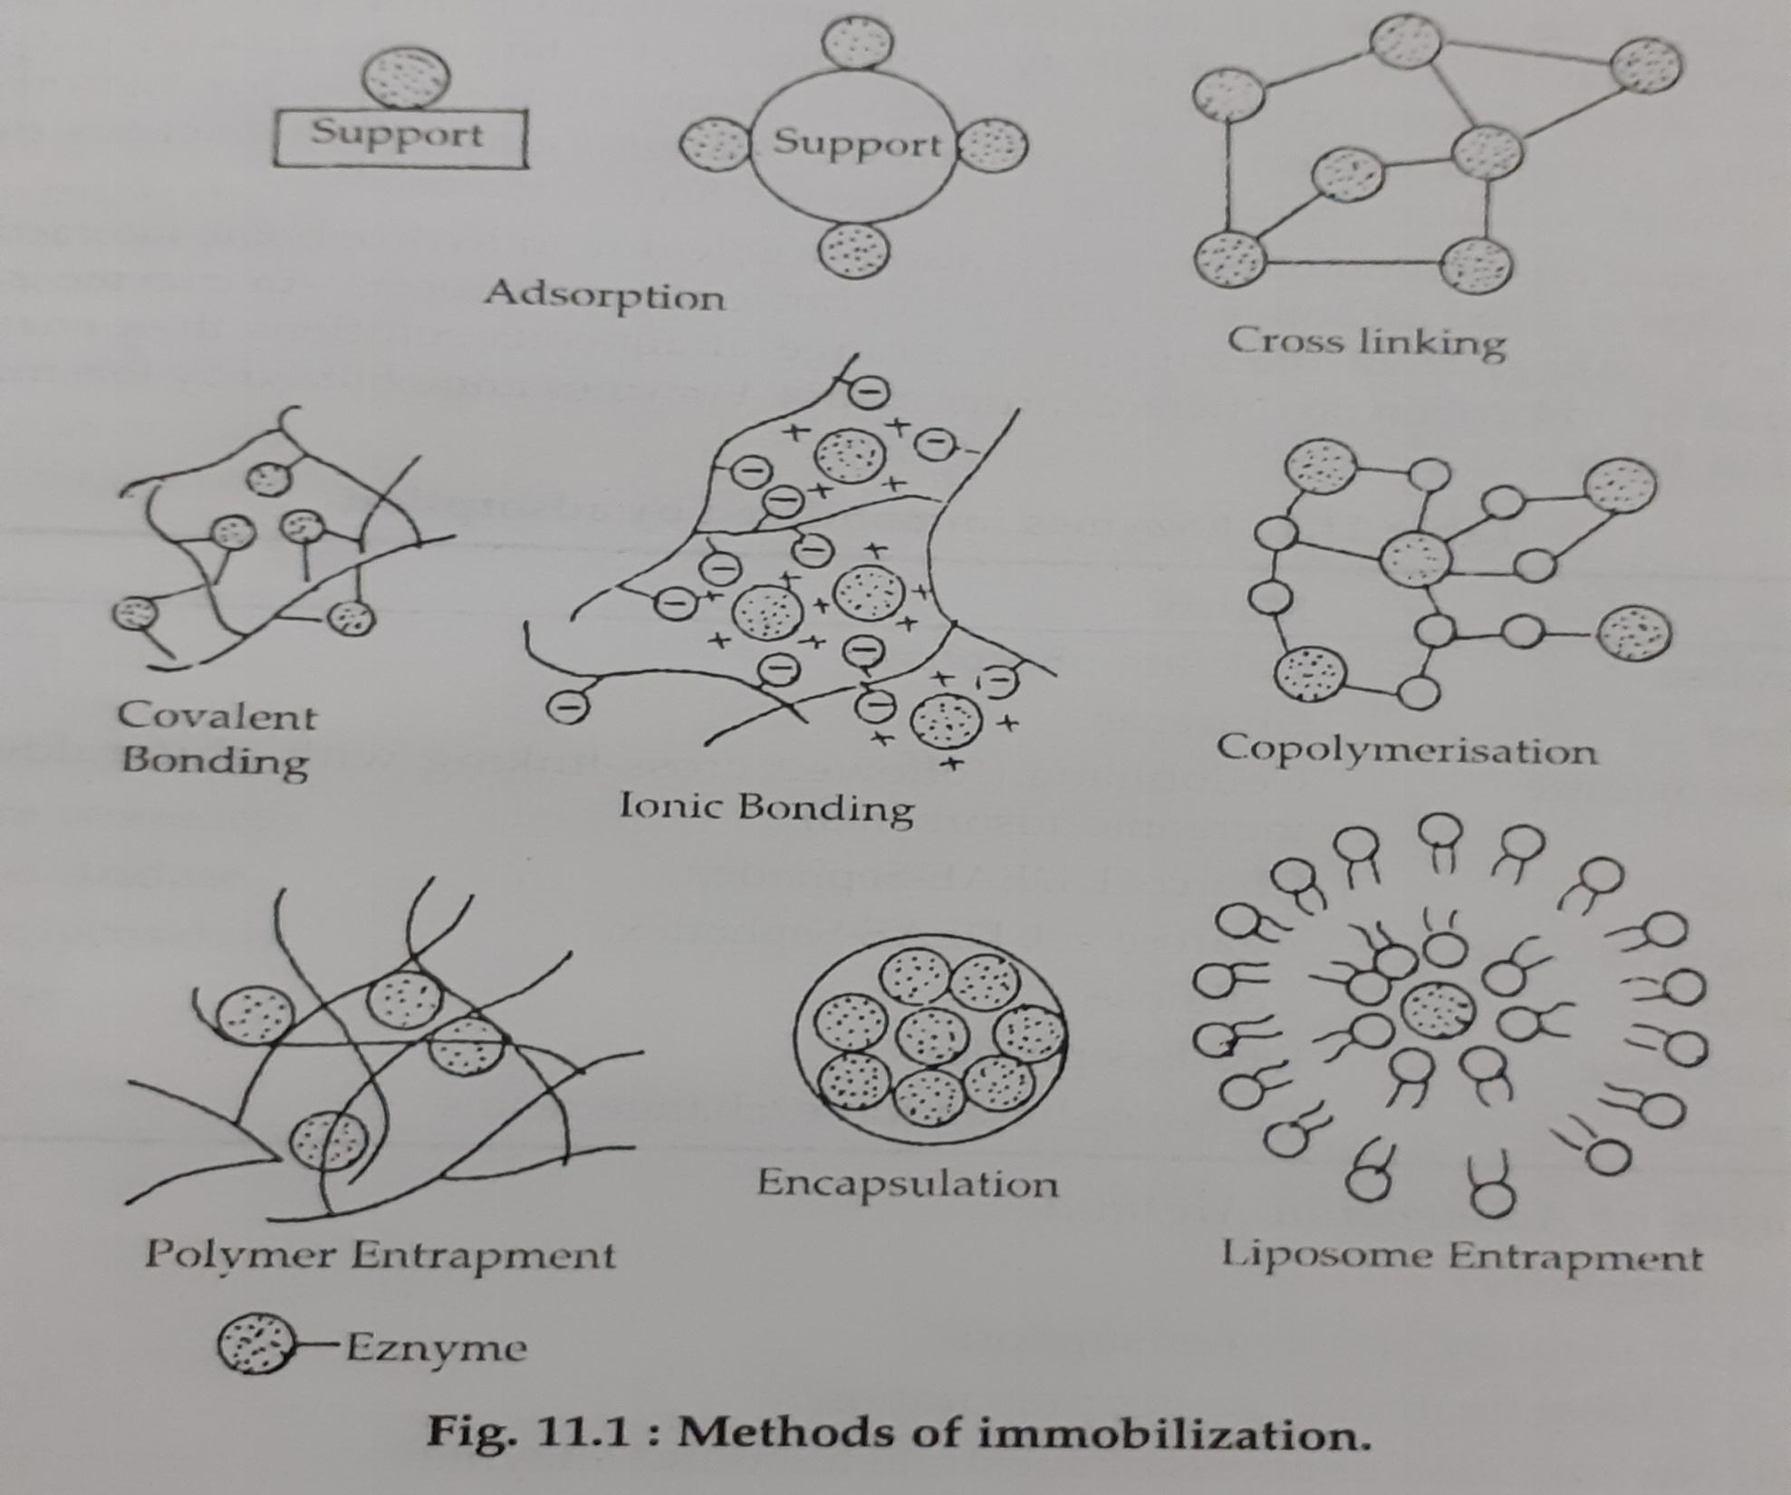

Slide 3
1. Adsorption :
- A suitable adsorbents showing high affinity towards biocatalyst causing minimal denaturation are employed.
- Mechanism of adsorption is an electronic interaction between the charged support and charged cell.
- This depends on chemical nature of cell wall, provide ionic sites for attachment to a charged support.

Slide 4
- Carrier and biocatalysts are held to gether through van-der-waals bonding forces, ionogenic bonds or H- bridges.
- Many organic of synthetic or biological origin have been used as support materials.
- Important factor is the bonding strength to the surface properties of the adsorbents and cells – Binding is generally not too strong.

Slide 5
  Advantages :
    - Simple for biocatalyst preparation.
    - Avoiding toxic chemicals or non-physiological condition possible.
    Physiological property of surface adherence of a number of cell avoiding systems favours such application.
    Disadvantages :
    Weak bonding and less stable

Slide 6
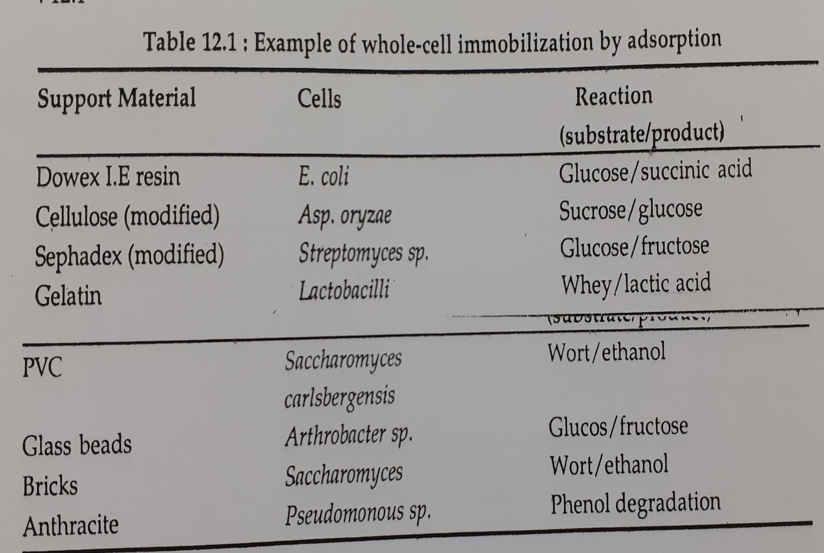

Slide 7
Covalent Bonding :
- Linkage of biocatalysts to the carrier through reactive group on the matrix.
- Coupling agents such as gluteraldehyde, diisocyanate, aminosilane, cabodimide may be employed.
- Cells can be attached to carrier surface by covalent bonding.

Slide 8
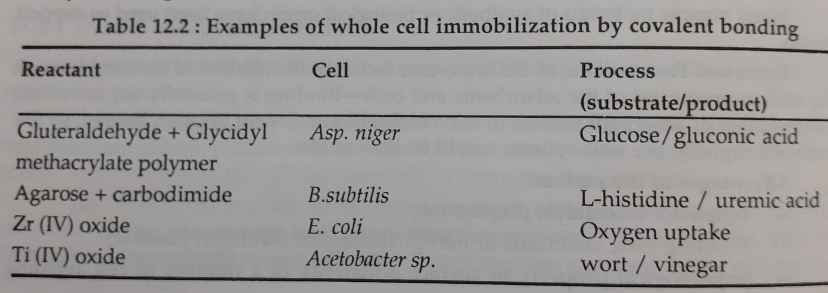

Slide 9
Cross Linking :
- Cell walls of microbes contains free amino or carboxyl groups, which can be cross-linked by bi- or multi functional reagent i.e. gluteraldehyde or toluene diisocyanate.
- Cells can also be immobilized by ionic cross-linking through flocculation by addition of polyelecrolyte.
- Cross-linking can also be employed in combination with entrapment techniques.

Slide 10
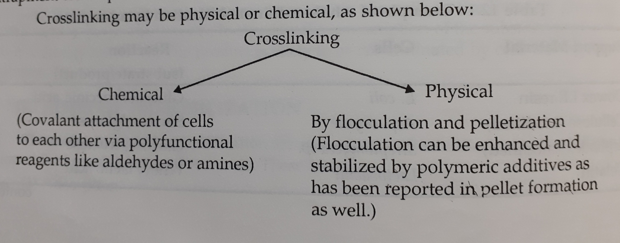

Slide 11
  Disadvantages :
  - Toxicity of chemicals limits the applicability of these methods.
  Advantages :
  - It leads to high cell concentration per unit volume of reactor.
  Examples of cell immobilization by cross linking are listed in table :

Slide 12
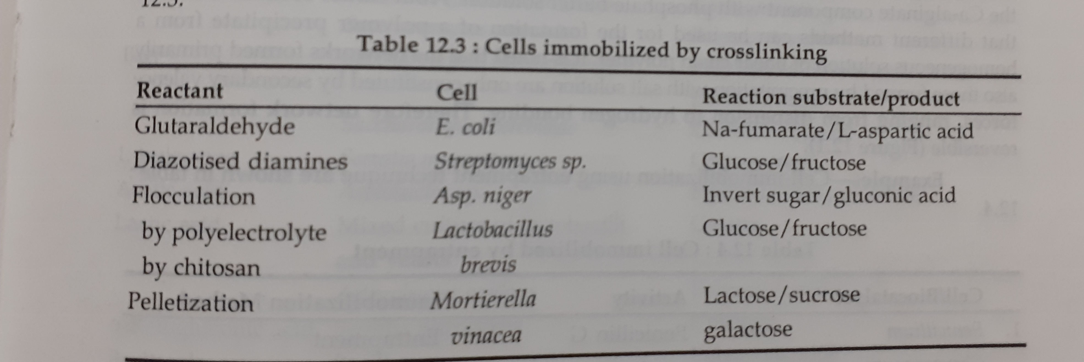

Slide 13
Copolymerization :
- It is the extension of cross linking.
- An inert ‘Spacer’ such as gelatin, albumin, or polyethyleneimine is added to the cell suspension before cross linking with glutaraldehyde.
- This results in biocatalyst with cells entrapped in a covalent network.

Slide 14
  Entrapment :
  Most widely used method for the immobilization of whole cells.
  Several polymer hydrophilic gels such as polyacrylamide, agar, Ca-alginate, K-carrageenan and gelatin are used.
  Limitation with gel carrier is that of diffusional restrictions.
  High porosity of gel is desirable.

Slide 15
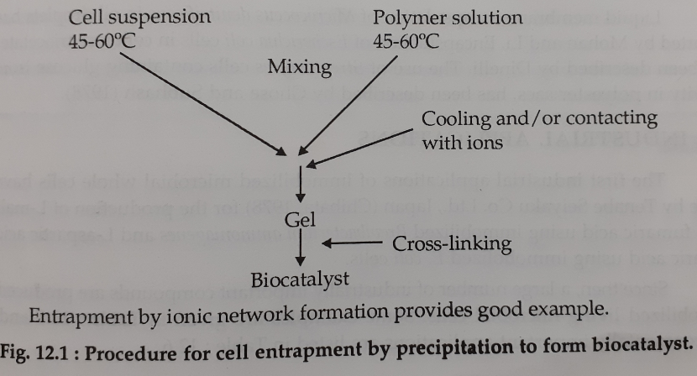

Slide 16
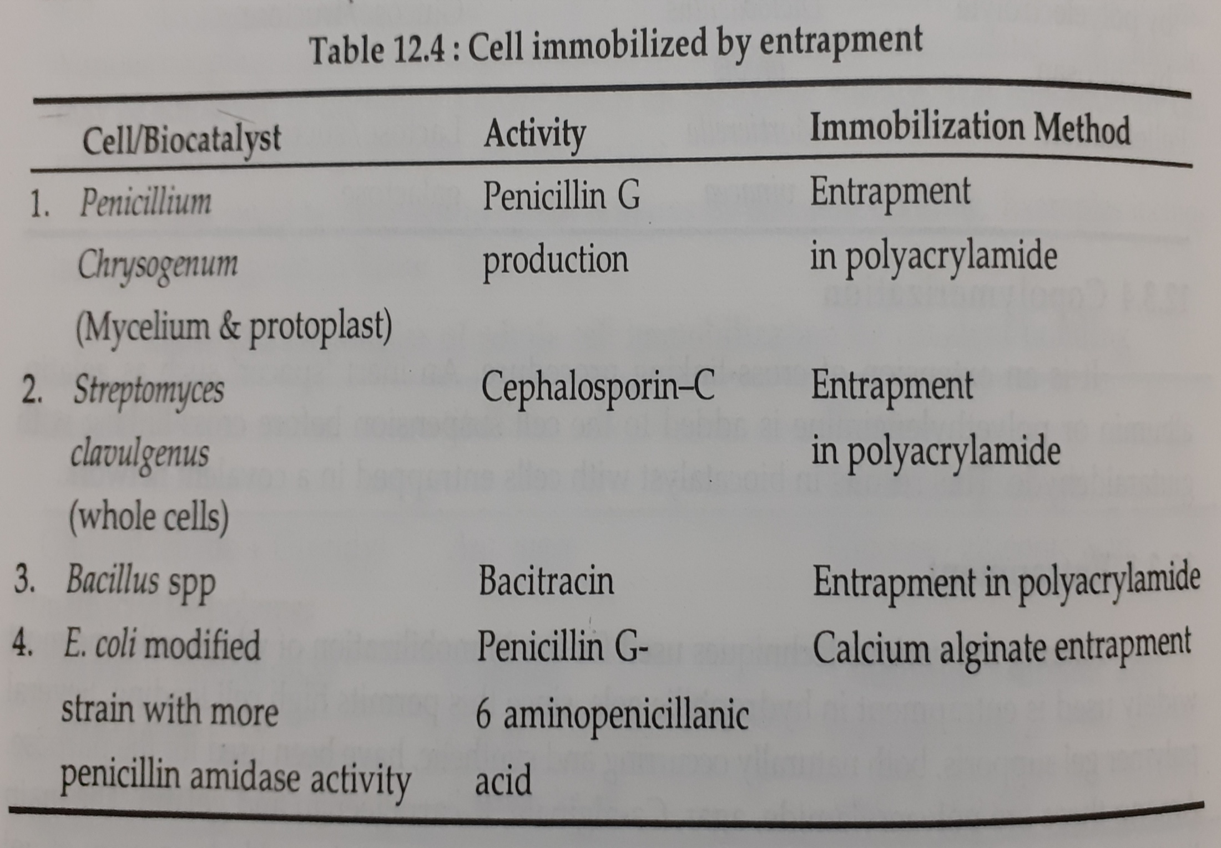

Slide 17
Microencapsulation :
- Liquid membrane encapsulation of Micrococcus denitrificans in oil droplets has been reported by Mohan and Li.
- Encapsulation of E.coli in cellulose triacetate fibers has been described by Dinelli.
- Streptomyces cells containing glucose isomerase activity in polyester sacs has been described by Ghose and Subhash (1978).

Slide 18
  Industrial Application :
  - The first industrial application of immobilized microbial whole cells have been made by Tenabe Seiyaku Co. ltd; Japan (Chibata, 1978) for the production of L-malic acid from fumaric acid using immobilized Brevibacterium ammoniagenes and L-aspartic acid from fumaric acid using immobilized E.coli cells.

Slide 19
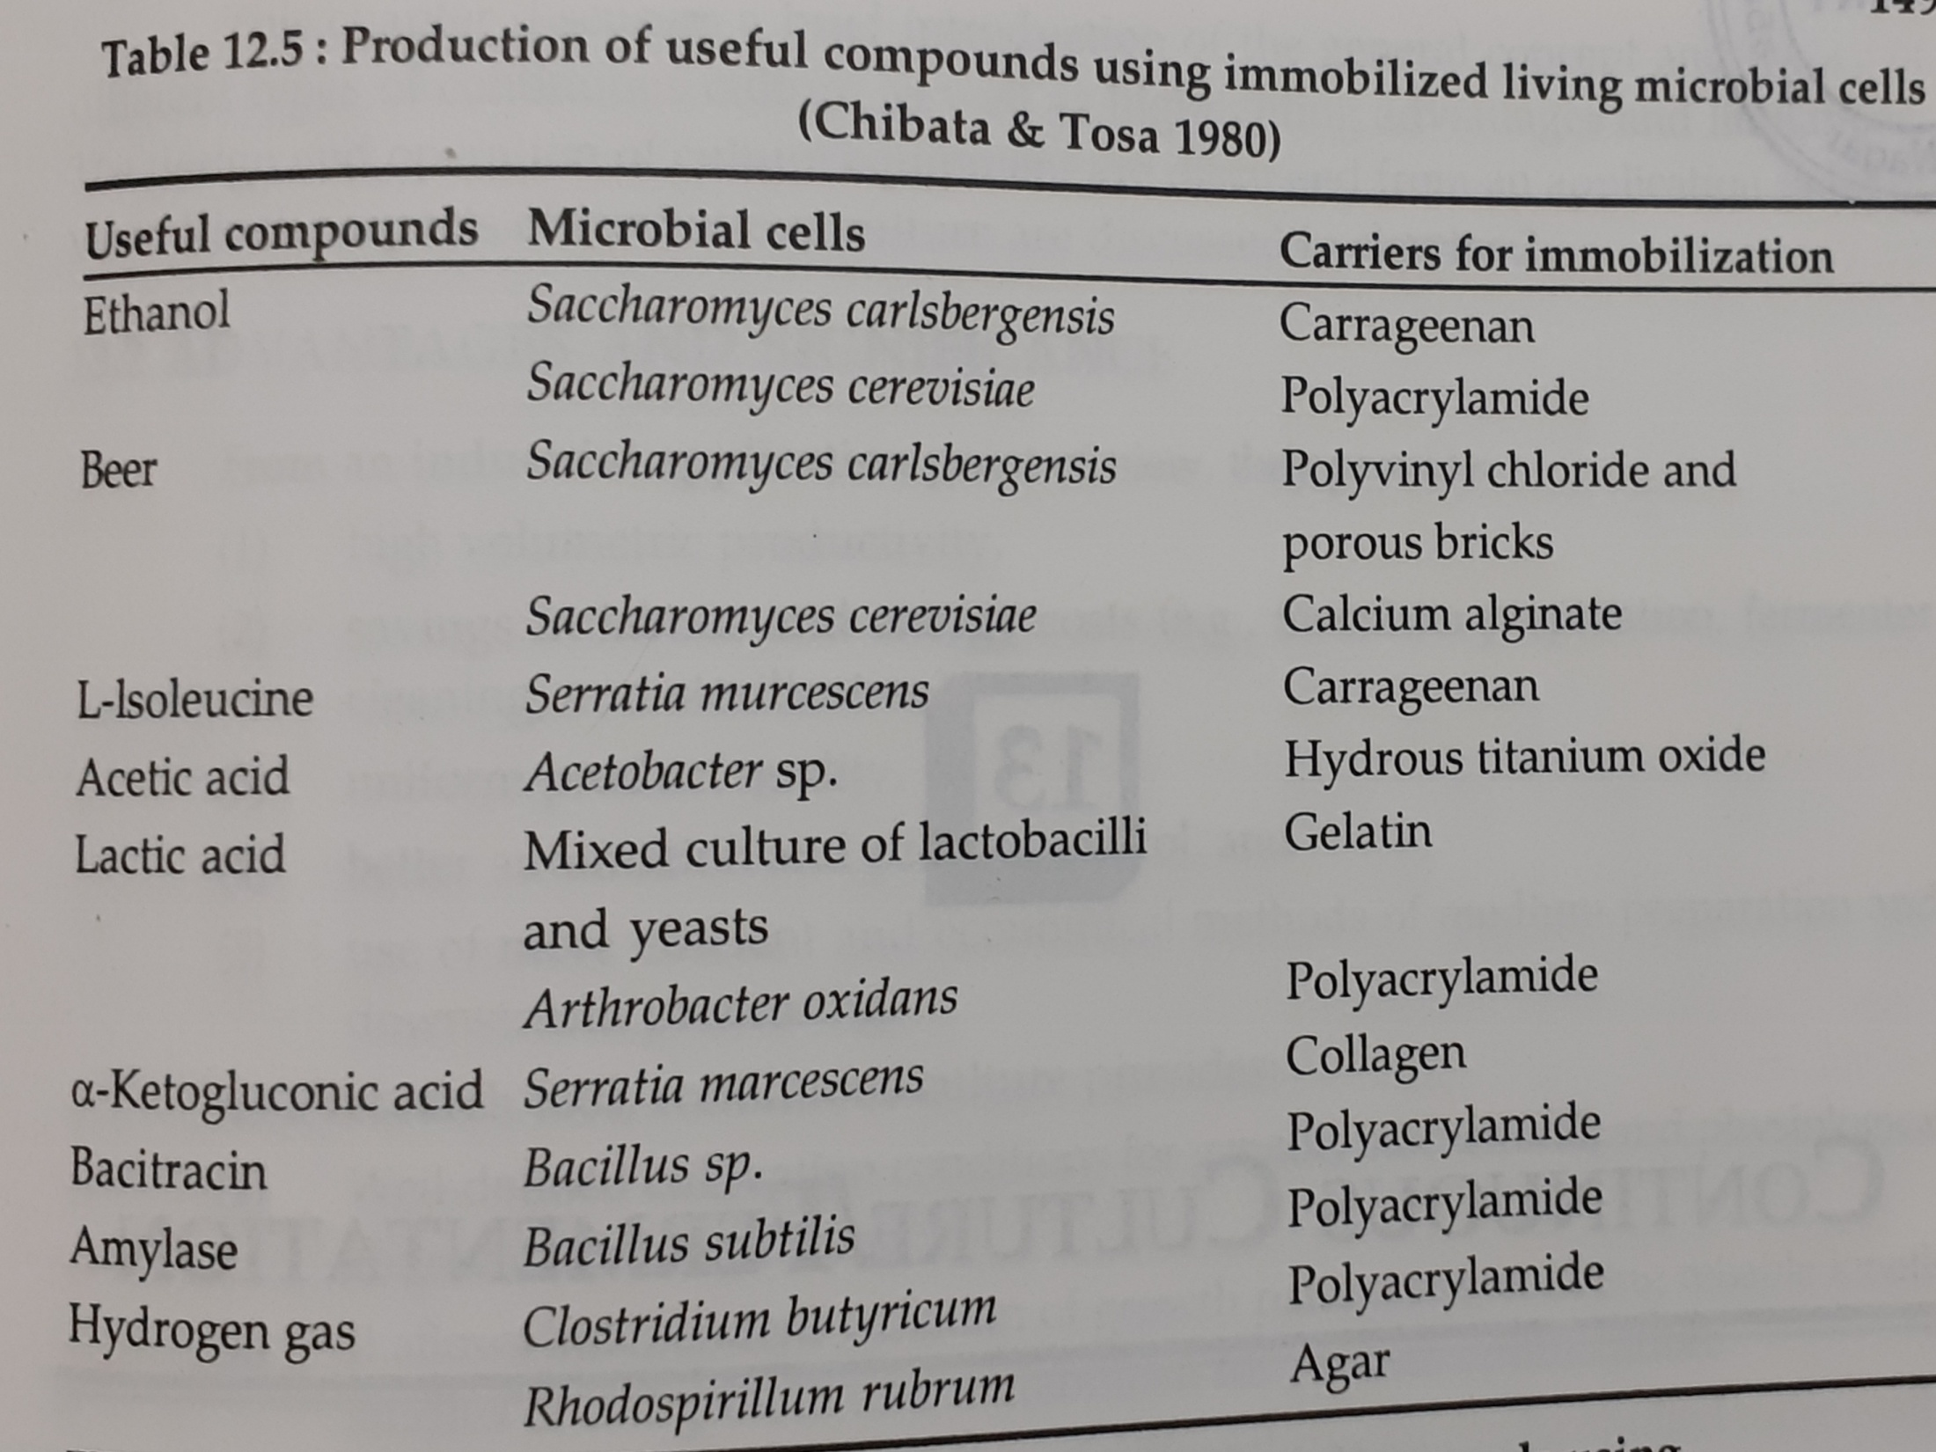

Slide 20
