Slide 1
Nutritional requirements of bacteria.
Phototrophs
Chemotrophs
Lithotrophs : Photolithotrophs and Chemolithotrophs
Organotrophs : Photoorganotrophs and Chemoorganotrophs
Autotrophs
Heterotrophs

Slide 2
All organisms require nitrogen for cell components.Bacteria are extremely versatile in a sense that some can use atmospheric nitrogen,others depend on inorganic nitrogen compounds like nitrates,nitrites or ammonium salts and still others derive nitrogen from organic compds.like amino acids.
All organisms require Oxugen,sulfur and phosphorus to synthesize cellular components.oxygen is provided mainly in form of water.sulfur is needed for making certain amino acids like cysteine,methionine.bacteria utilize organic,inorganic or elemental sulfur. Phosphorus is supplied in form of phosphates which is essential component of nucleic acids,phospholipids and teichoic acids.

Slide 3
All organisms require metal ions such as potassium,calcium,magnesium and ferrous for the growth.other metal ions like Zn,Cu,Mn,Mo,Ni are required but in less amount and they are called trace elements.
All organisms require vitamins and vitamin like compds.some are capable of synthesizing their entire requirements of vitamins from other compds.in culture medium but others can not do so and will not grow unless required vitamins are supplied to them.
All living organisms require water and in case of bacteria,all nutrients must be in aqueous solution before they can enter the cells.moreover high specific heat of water provides resistance to sudden temp.changes in envt.it is also required for hydrolytic reactions carried out by a cell.

Slide 4
Common ingredients of culture media.
Peptone: It is an intermediate product of protein hydrolysis i.e.protein-proteose peptone-peptone-peptides-aminoacids.
The whole protein such as casein is normally not attacked by bacteria when it is incorporated in a medium as the only source of nitrogen as it is believed to be too large to enter a cell but if a trace of peptone is added to medium,it will enter a cell and stimulate production of extracellular proteolytic enzymes which attack the whole protein. The most imp.function of peptone is to provide nitrogen source and they are also excellent buffers.
2)Yeast extract: It is prepared by extracting autolysed yeast cells with water and evaporating the liquid to dryness.
It is an excellent source of B group of vitamins and superior to meat extract in most culture media.

Slide 5
3)Meat/Beef extract: It is prepared by cutting fresh,lean beef into pieces and place them in a vessel in appropriate amt. of water and heat it for several hrs.the liquid portion is poured off and solid material is subjected to gentle pressure to separate remaining liquid.the extract is called beef extract.
It is added to media to supply substances that stimulate bacterial activity.It contains water soluble substances of animal tissues which include carbohydrates,organic nitrogen compds.,water soluble vitamins and salts.
4)Nacl: Although it is not necessary for growth,it is commonly added to culture media to maintain osmotic balance.
5)Agar: It is the dried mucilaginous sub.extracted from Gelidium corneum and related algae.It is used as a solidifying agent It melts at a very high temp. and gels at low temp.it is not considered as a source of nutrients.
6)Inorganic requirements:This includes Na,K,Mg,Fe,S and P in addition,Cl,C,N and H are usually obtained from organic matter.

Slide 6
Composition of Nutrient broth:
Peptone- 1%
Meat extract- 0.3%
Nacl- 0.5%
D.W.-100 ml.
pH-7
If solid medium is required then add agar agar powder-3%
sterilize the medium in autoclave.

Slide 7
7)Fermentable compds.: they serve two functions in media.(i) they are readily available source of energy,provided organisms are able to utilize them and(ii) fermentations reactions are helpful in identifying and classifying organisms.
Such compds.include (A)monosaccharides-pentoses like ribose,xylose Hexoses like glucose galactose (B) disaccharides like lactose,maltose,sucrose © trisaccharides like raffinose (D) polysaccharides like cellulose,starch
It also includes glucosides and non carbohydrate compd.like inositol
8)gelatin:initially used as a solidifying agent but not now.silica gel

Slide 8
Types of Media.
Culture media can be broadly classified into 3 types.
On the basis of nature of ingredients: here,they are classified into two types.
A)Synthetic media:They are composed of compounds of known chemical composition.they may be composed entirely of inorganic salts or mixture of inorganic salts and organic compds.or inorganic and organic compds.with added vitamins.the nutritional requirements of bacteria can be accurately determined by synthetic media.
B)Non synthetic media:They are composed of ingredients of unknown chemical composition.some of these ingredients include peptone,beef extract,yeast extract,blood etc.The usual culture media employed in routine laboratory are non synthetic.

Slide 9
2)On the basis of application and functions:they are classified as follows.
Selective media:These media provide nutrients which increase the growth and predominance of particular type of org.and may even inhibit yhe growth of other org.For e.g. medium in which cellulose is the only carbon source will specifically select the growth of cellulose utilizing org.when it is inoculated with soil sample containing many kinds of bacteria.
Differential media:Certain reagents or supplements when incorporated into culture media may allow differentiation of various kinds of bacteria.For e.g. if a mixture of bacteria is inoculated onto a blood containing agar medium,some of the bacteria may hemolyze or destroy red blood cells while others do not.thus we can differentiate between hemolytic and nonhemolytic bacteria on the same medium.
Selective as well as differential media: e.g.MacConkey’s and EMB media.
MacConkey’s medium contains bile salt such as sodium taurocholate,Lactose sugar,pH indicator dye like neutral red,peptone etc.
Selective-for Gram negative enteric group of bacteria.
Differential:differentiates between lactose fermenting and nonfermenting bacteria E.coli and Salmonella typhi.
EMB:differentiates between lactose fermenting bacteria.E.coli produces dark centered colonies with green metallic sheen due to mixed acid fermentation while Enterobacter aerogenes produces pink colored mucoid colonies due to butane-diol fermentation.

Slide 10
D)Assay media:These are media of prescribed composition and are used for assay of vitamins,aminoacids and antibiotics.
E)Media for enumeration:special kinds of media are used for determining the bacterial content of milk and water.however their composition must attach to prescribed specification.
F)Media for characterization:They are used to determine the type of growth produced by bacteria and also to determine their ability to produce certain chemical changes.
G)Maintenance media:satisfactory maintenance of viability and physiological characters of a culture may require a medium different from that which is optimum for growth as rapid growth may also be associated with rapid death of cells at the end of growth phase.
H)Enrichment medium:this medium is used to increase in the relative number of species upto the point where species become dominant of the population.For this selective methods are used. These media are usually in liquid form.
I)Enriched media: they are usually enriched with nutritionally rich substances such as blood,etc.
3) On the basis of physical state: classified into 3 types
a)Solid media b) Liquid media c) Semi solid media.

Slide 11
Nutritional types of bacteria
Phototrophs: Among phototrophic bacteria,there are species which use inorganic compds.as their source of electrons(i.e.photolithotrophs) For e.g. Chromatium okenii which uses H2S as electron donor,oxidizing it to elemental sulfur.
Some phototrophs use organic compds.such as fatty acids and alcohols as electron donors(i.e.photoorganotrophs) For e.g.Rhodospirillum rubrum can use succinate as electron donor and converting it to fumerate.
Certain phototrophs are not restricted to being phototrophic and under certain circumstances,it can grow as a chemotroph.For e.g.in absence of oxygen,R.rubrum is dependant on light as its source of energy and lives as photoorganotroph but in presence of oxygen,it can grow in dark as chemoorganotroph.

Slide 12
Chemotrophs: Among chemotrophic bacteria there are species that use inorganic compds.as their source of electrons(i.e.chemolithotrophs) For e.g.bacteria of the genus Nitrosomonas use ammonia as their electron source,obtaining energy by oxidizing ammonia to nitrite.
Many other chemotrophs use organic compds.such as sugars and amino acids as electron donor and are chemoorganotrophs.
Certain bacteria can grow as either chemolithotrophs or chemoorganotrophs.For e.g.Pseudomonas pseudoflava can use either organic compd.glucose or inorganic compd.hydrogen as its source of electrons.

Slide 13
Autotrophs: They use CO2 as the sole source of carbon.It was believed that all chemolithotrophs were autotrophs.this is true for most chemolithotrophs but few are now recognised as being chemolithotrophic heterotrophs i.e.mixotrophs they obtain energy by utilizing inorganic compds.as electron donor but obtain most of their carbon from organic compds.e.g.is Desulfovibrio desulfuricans.
Some autotrophs are facultative autotrophs i.e.they can either live as autotrophs,deriving their carbon from CO2 or they can live as heterotrophs,deriving carbon from organic compds.e.g.Pseudomonas pseudoflava. It can live as heterotroph using glucose as source of carbon and energy but if hydrogen is provided as electron source,then it can use CO2 as its sole carbon source and can grow as autotroph.

Slide 14
Heterotrophs: These bacteria have been studied more extensively as they are of immediate concern to us because almost all human pathogens are heterotrophs.e.g.E.coli and Lactobacilli however E.coli has much simpler nutritional requirements while Lactobacilli require specific nutrients like vitamins and other growth promoting sub. And so are called fastidious heterotrophs.
Obligate parasites:These bacteria have not yet been successfully cultivated on artificial media as their nutritional requirements are not properly understood.At present they are cultivated only in association with a living host which in a sense serves as a medium.Examples include Mycobacterium leprae causing leprosy.then spirochaete lie Treponema pallidum causing syphilis. Other e.g. include Rickettsias and Chlamydias.

Slide 15
Preservation of pure cultures.
There are several methods of preservation.
Periodic transfer to fresh media: The temperature and the type of medium selected should support a slow rather than rapid rate of growth,so that the time interval between transfers can be as long as possible.many organisms can remain viable for several months in refrigerator even on nutrient agar however,the disadvantage is method fails to prevent changes in character of a strain.
By overlaying cultures with mineral oil: Many bacteria can be successfully preserved by covering the growth on agar slant with sterile mineral oil.The oil must cover the slant completely.The method has an advantage that one can remove some of the growth under the oil and inoculate a fresh medium and still preserve the original culture.however,changes in the characters of strain is still the problem,

Slide 16
3) Lyophillization or Freeze-drying: Many bacteria die if cultures are allowed to become dry however this method can preserve many kinds of bacteria which would be killed by ordinary drying. In this method,a dense cell suspension is placed in small vials and frozen at -60 to -80C The vials are then connected to a high vacuum line.The ice present in frozen suspension sublimes under vacuum i.e.evaporates without first going through liquid water phase. This results in dehydration of bacteria. The vials are then sealed off under vacuum and stored in refrigerator. Many species can be preserved by this method for more than 30 years.
4)Storage at low temperature: In this method,a dense cell suspension is prepared in a medium containing cryoprotective agent such as glycerol or dimethyl sulfoxide(DMSO) This will prevent cell damage due to ice crystal formation The cell suspension is sealed into small vials and frozen at -150C The vials are then stored in liquid nitrogen refrigerator
However the method is relatively expensive due to liquid nitrogen .

Slide 17
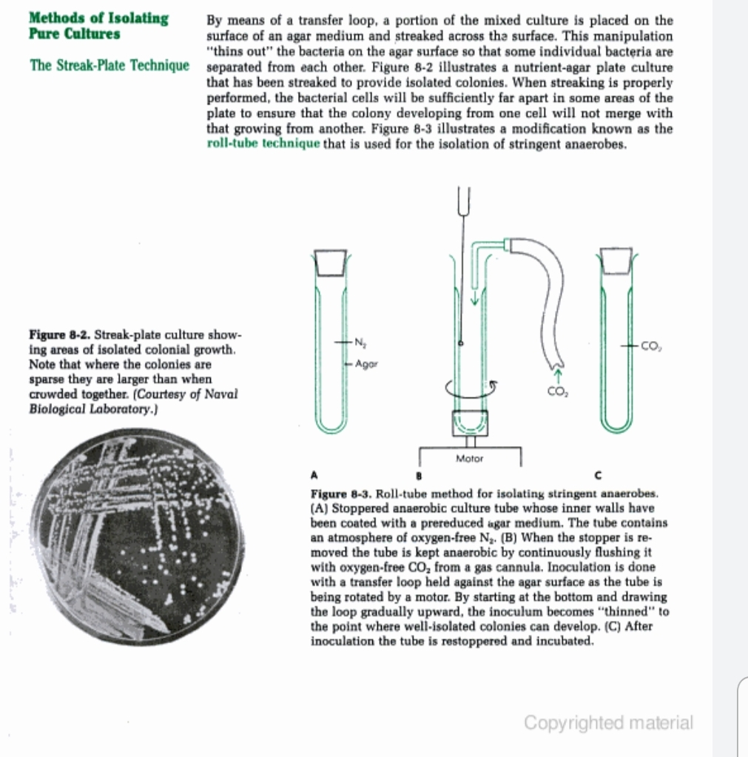

Slide 18
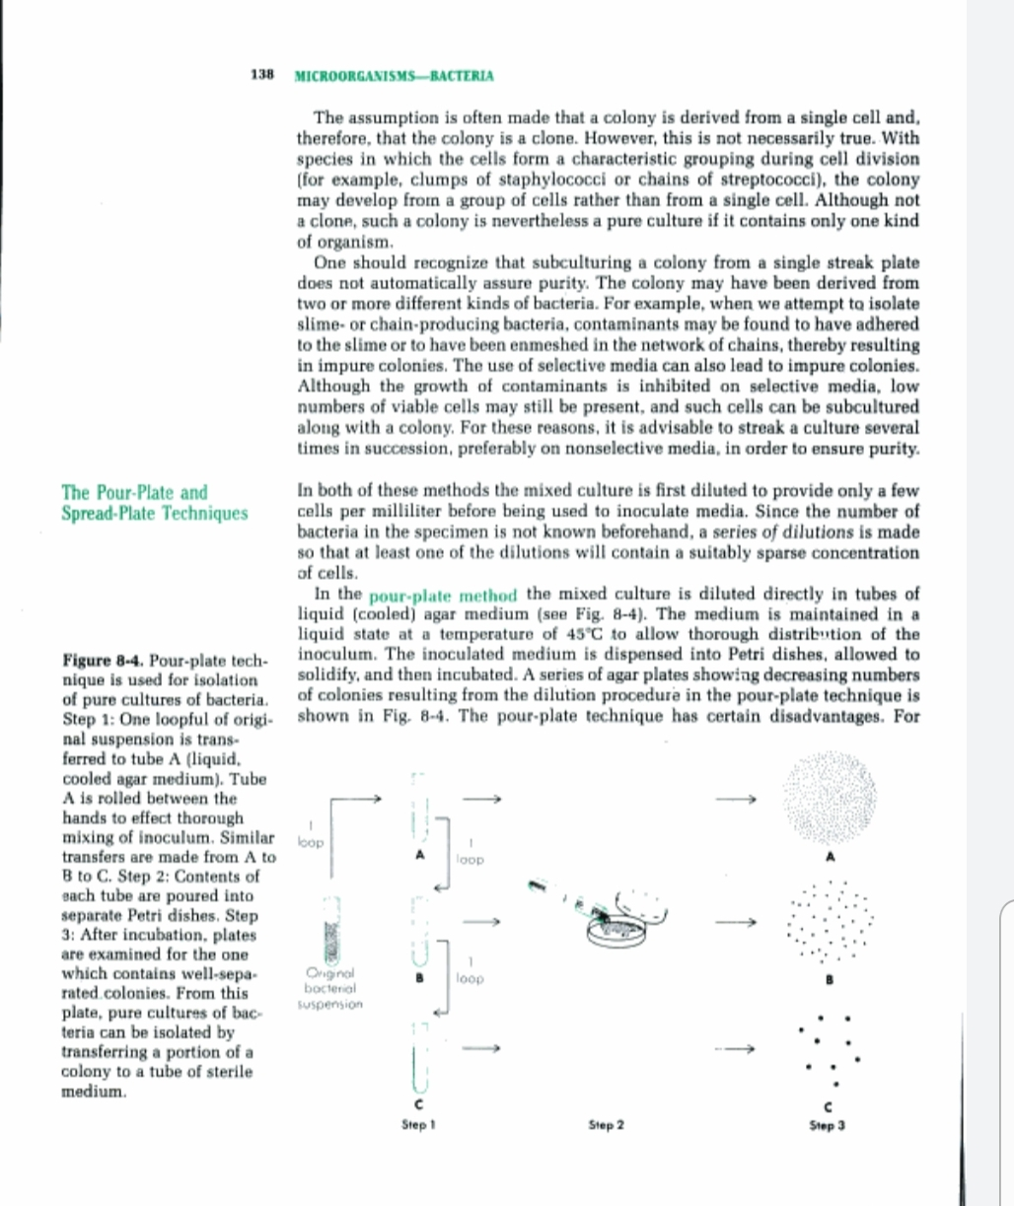

Slide 19
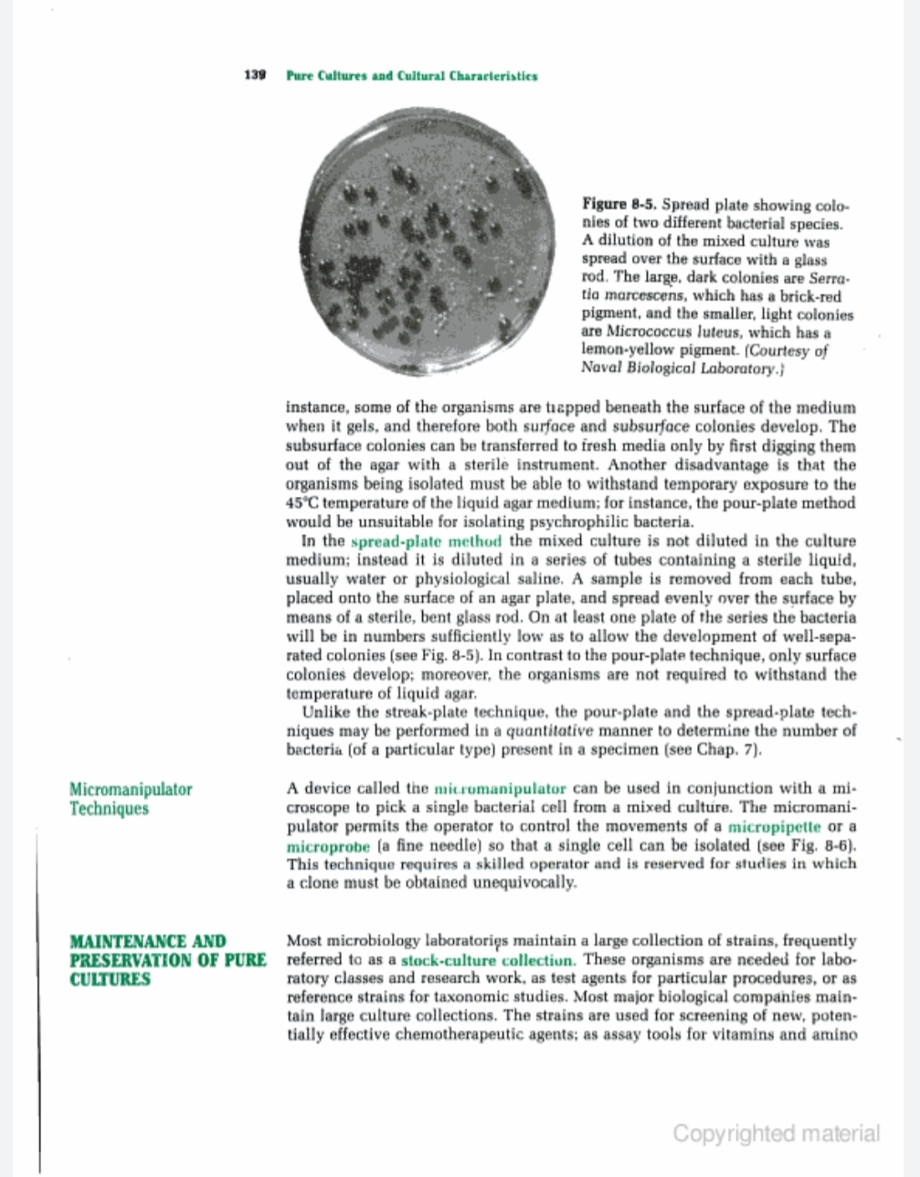

Slide 20
