Slide 1
UNIT – III Polarization
By- Dr P M Patel
Introduction:
Interference and diffraction phenomena proved that light is a wave motion
These phenomena are used to find wavelength of light and they do not give any indication regarding the character of waves.
Interference and diffraction phenomena proved that light is a wave motion.
Maxwell developed electromagnetic theory and suggested that light-waves are electromagnetic waves.

Slide 2
Electromagnetic waves are transverse waves, so it is obvious that light waves are also transverse waves.
Longitudinal waves are waves in which particles of medium oscillate along the direction of propagation of wave (e.g. sound wave).
Transverse waves are waves in which particles of medium oscillate perpendicular to the direction of propagation of wave. (e.g. Electromagnetic waves.)
Polarization is possible in transverse wave

Slide 3
Unpolarized Light is the light is which the planes of vibration are symmetrically distributed about the propagation direction of the wave.
Plane Polarized light is a wave in which the electric vector is everywhere confined to a single plane.
A linearly polarized light wave is a wave in which the electric vector oscillates in a given constant orientation.

Slide 4
Production of Linearly Polarized Light:
Methods for producing Linearly polarized light :
Reflection
Refraction
Scattering
Selective absorption
Double reflection.
Applications of Polarized light:
Industry and Engineering fields
In liquid crystal displays (LCDs)
Widely used in wristwatches, calculators, T.V. Screens
optical fibers.

Slide 5
Polarization by reflection:
In 1808, E.L.Malus discovered the polarization of natural light by reflection from the surface of glass.
He noticed that when natural light is incident on a plane sheet of glass at a certain angle, the reflected beam is plane polarized.

Slide 6
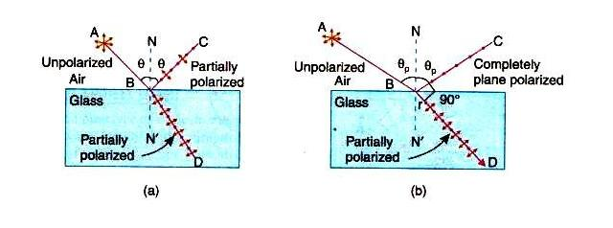

Slide 7
Brewster's Law
In 1892, Brewster performed number of experiments to study the polarization of light by reflection at the surfaces of different media.
He found that ordinary light is completely polarized in the plane of incidence when it gets reflected from a transparent medium at a particular angle known as the 'angle of polarization.'
He proved that 'the tangent of the angle of polarization is numerically equal to the refractive index of the medium.'
Also the reflected and retracted rays are perpendicular to each other.

Slide 8

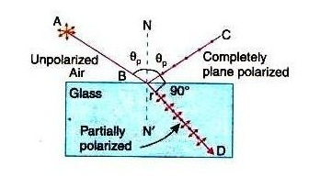
If is the angle and μ is the refractive index of the medium, then
This is known as Brewster’s law.

Slide 9




Brewster found that the maximum polarization of reflected ray occurs when it is at right angles to the refracted ray. It means that
According to Snell’s law,
Where, is the absolute refractive index of reflecting surface
is the refractive index of the surrounding medium.

Slide 10



The polarizing angle is also known as Brewster angle and denoted by

Slide 11


From Snell’s law, μ=
From Brewster's law, µ=tan i =
Comparing above equations,
cos i = sin r = cos (π/2 - r)
i = π/2 – r
i+r = π/2
Therefore the reflected and the retracted rays are at right angles to each other.

Slide 12
From Brewster's law, the value of 'i' for crown glass of refractive index 1.52 is given by.
i= tan⁻¹(1.52)
i= 56.7⁰
For ordinary glass the approximate value for the polarizing angle is 57⁰.
For a refractive index of 1.7, the polarizing angle is 59.5⁰. Thus the polarizing angle is not widely different for different glasses.

Slide 13
Applications of Brewster’s law
Brewster's law can be used to determine the reflective Indies of opaque materials.
It is used to calculate the polarizing angle for total polarization of reflected light, if reflective index of the material is known.
Brewster's angle can be utilized for transmitting a light beam in into or out of an optical fiber without reflections losses.

Slide 14
Polarization by refraction-pile of plates
When unpolarized light is incident at Brewster's angle on a smooth glass surface, the reflected light is totally polarized while the refracted light is partially polarized.
If natural light is transmitted through a single plate, they it is partially polarized.
If a stack of glass plates is used instead of a single plates, reflections from successive surfaces of each glass plate filter the perpendicular component from the transmitted ray.
The transmitted ray consists of only parallel components.

Slide 15
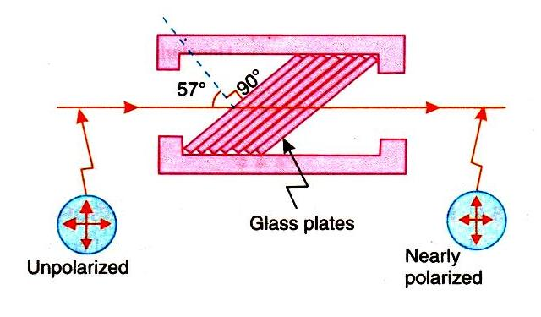

Slide 16

I_{p}- Intensity of parallel component of refracted light.
I_{s}- intensity of perpendicular component of light.
Thus, degree of polarization of refracted (transmitted) light is given by
where m= no. of plates required.
μ= refractive index of material.

Slide 17
About 15 glass plates are required for this purpose.
The glass plates are kept inclined at an angle of 33⁰ to the axis of the tube
This arrangement is called a pile of plates.
When unpolarized right is incident on the plates at Brewster angle, the transmitted light will be polarized and parallel to the plane of incidence.
Drawback: The drawback of this method is good portion of light is lost in reflections.

Slide 18
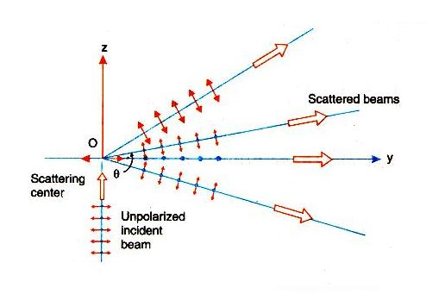
Polarization by Scattering

Slide 19
If a narrow beam of natural light is incident on a transparent medium, contain a suspension of ultramicroscopic particles, the scattered light is partially polarized.
The degree of polarization depends on the angle of scattering. The beam scattered at 90⁰ with respect to the incident direction is linearly polarized

Slide 20
Sun light scattered by air molecules is polarized.
The maximum effect is observed on a clear day when the sun is near the horizon.
The light reaching on the ground from directly overhead is polarized to the extent of 70% to 80%.

Slide 21
Polarization by Selective absorption
In 1815 Biot discovered that certain mineral crystal absorbs light selectively.
When natural light passes through a crystal such as tourmaline, it splits into two components which are polarized in mutually perpendicular places.
The crystal strongly absorbs light that is polarized in a direction parallel to a particular plane in the crystal but freely transmits the light component polarized in a perpendicular direction.
This difference in the absorption for the rays is known as selective absorption or dichroism.

Slide 22
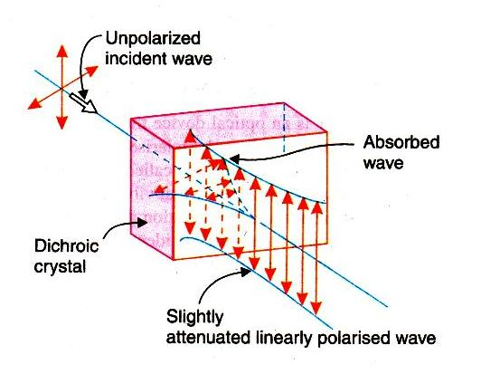

Slide 23
The difference in absorption in different direction may be understood from the electron theory.
When the frequency of incident light wave is close to natural frequency of the electron cloud, the light waves are absorbed strongly.
Crystals that exhibit selective absorption are anisotropic.
The crystal splits the incident wave in to two waves.
The component having its vibration perpendicular to the principal plane of the crystal gets absorbed.
The component with parallel vibrations is less absorbed and it is transmitted. The transmitted light is linearly polarized.
The drawback of this method is that the crystal of bigger size cannot be grown.

Slide 24
Polarization by double refraction
This phenomenon was discovered by Erasmus Bartholinus in 1969.
When light is incident on a calcite crystal, it splits into two refracted rays.
This phenomenon is called double refraction or birefringence. The crystal is called birefrigent.

Slide 25
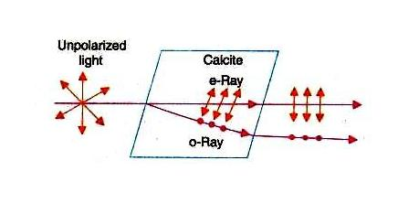
The two rays produced in double refraction are linearly polarized in mutually perpendicular directions.
The ray which obeys Snell's law of refraction is known as ordinary ray or o-ray.
The other ray does not obey Snell's law is called extraordinary ray or e-ray.

Slide 26
Polarizer and Analyzer
Polarizer:-
It is an optical device that transforms unpolarized light into polarized light. If it produces linearly polarized light. It is called a lineally Polarizer.
If natural light is incident on a linear polarizer, only that vibration which is parallel to the transmission axis is allowed to pass through the polarizer while the vibration that is in a perpendicular direction is totally blocked.

Slide 27
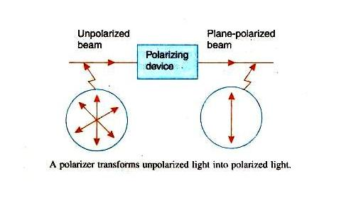
Analyzer:-
Analyzer is a device, which is used to find whether the light is polarized or unpolarized.
Both polarizer and analyzer are fabricated in the same way and wave the same affect on the incident light.

Slide 28
NICOL'S PRISM
A Nicol prism is made from calcite crystal.
It was designed by William Nicol in 1820.
A calcite crystal whose length is three times as its width
The end faces of this crystals are grounded in such a way that the angles in the principal section becomes 68⁰ and 112⁰ instead of 71⁰ and 109⁰
The crystal is cut in two pieces by a plane perpendicular to the principal section as well as the new end faces.
The two parts of the crystal are then cemented together with Canada balsam.
The refractive index of Canada balsam lies between the refractive indices for the ordinary and extra-ordinary rays for calcite.

Slide 29
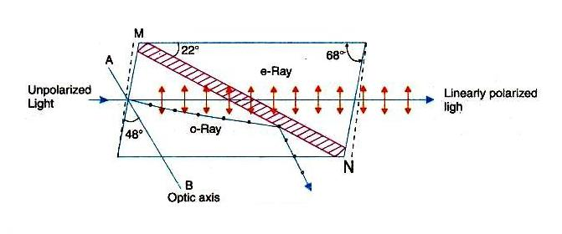
(µ₀=1.66, µ_{e} =1.486 and µ_{Canada balms =} 1.55)

Slide 30
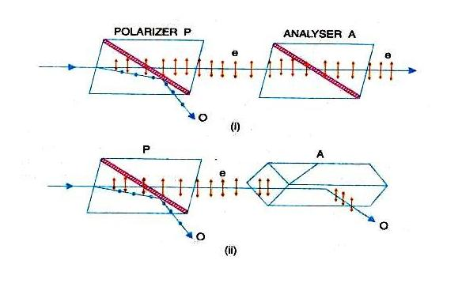
Working of Nicol Prism as Polarizer and Analyzer

Slide 31
Polaroid Sheets
In 1928 E.H. Laud developed a method of aligning small crystal to obtain large polarizing sheets.
The sheets are called Polaroid sheets.
Constructions:-
A clear plastic sheet of long chain molecules of polyvinyl alcohol (PVA) is heated.
It is then stretched in a given direction to many times its original length.
During this process, PVA molecules become aligned along the direction of stretching.

Slide 32
The sheet is laminated to a rigid sheet of plastic.
It is then exposed to iodine vapour.
The iodine atoms attach themselves to the straight long chain of PVA molecules.
The conduction electrons associated with iodine can move along the chains.
A sheet fabricated according to this process is known as H-sheet.

Slide 33
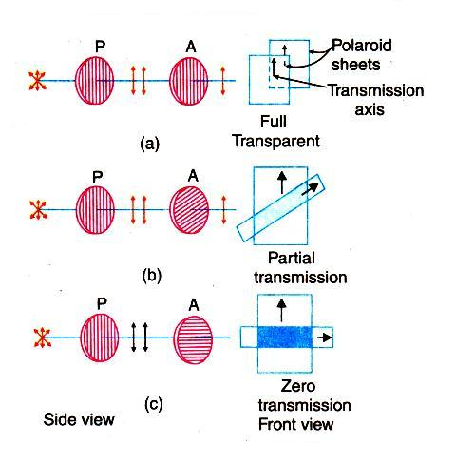
Polaroid Sheets as Polarizer and Analyzer

Slide 34
Fig (a) - transmission axis of the analyzer A is parallel to polarizer P so light passes through the analyzer.
Fig (b) Transmission axis is at angle θ so light partially transmitted.
Fig(c) When the axes are perpendicular to each other, no light is transmitted.

Slide 35
Working
When natural light is incident on the sheet, the component that is parallel to the chains of iodine atoms induces current in the conducting chains and is therefore strongly absorbed.
Thus the transmitted light contains only the component that is perpendicular to the direction of molecular chains.
The direction of E-vector in the transmitted beam corresponds to the transmission axis of the Polaroid sheet.

Slide 36
These sheets are expensive and can be made in large sizes.
They are widely used in sunglasses, camera filters etc. to eliminate the unwanted glare from objects.
They can be used as polarizer and analyzer.

Slide 37
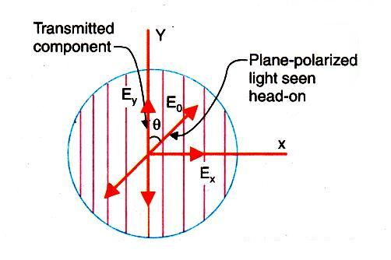
Effect of Polarizer on Natural light:
When unpolarized light passes through a polarizer, the intensity of the transmitted light will be exactly half that of the incident light.

Slide 38


Let E₀ is the amplitude of vibration of the unpolarized light incident on the polarizer.
Let E₀ makes an angle with the transmission axis of the polarizer.
Here E₀ may be resolved into two components E_{x} and E_{y}
The polarizer blocks the component E_{x} and transmits the component E_{y}.
The intensity of the transmitted light

Slide 39



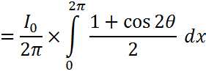
Intensity (Amplitude)²
Now, the value is from 0 to 2π because unpolarized light has all possible vibrations.

Slide 40
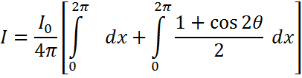



Thus, the intensity of transmitted light through the polarizer is half the intensity of incident light.

Slide 41
Effect of analyzer on plane polarized light- Malus law
When natural light is incident on a polarizer, the transmitted light is linearly polarized. If this light-further passes through an analyzer, the intensity varies with the angle between the transmissions axes of polarizer, and analyzer.
Malus studied their phenomenon and known as Malus law.
Statement:
"The intensity of the polarized light transmitted through the analyzer is proportional to cosine square of the angle between the plane of transmission of the analyzer and plane of transmission of the polarizer."

Slide 42
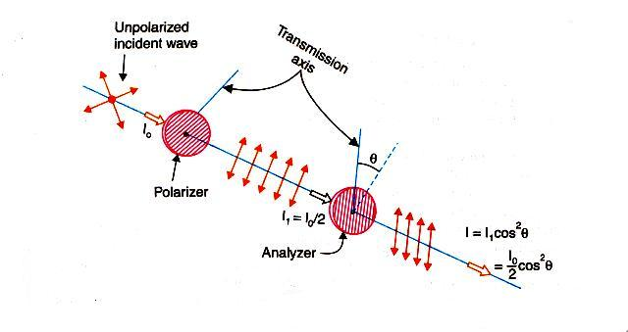

Slide 43
Let I₀ is the intensity of unpolarized light.
The intensity of polarized light from the polarizer is I₀/2.
Taking I₁=I₀/2.
This plane polarized light then passes through the analyzer.
Let E is the amplitude of vibration and is the angle between this vibration and transmission axis of an analyzer.

Slide 44


E resolves into two components
E_{y} parallel to the plane of transmission of the plane of analyzer, and
E_{x}, perpendicular to the plane of analyzer.
E_{y} component is only transmitted through the analyzer.
Intensity of light for this component:

Slide 45




If,
, then axis are parallel I= I₁
, then axis are perpendicular I= 0
, then axis are parallel I= I₁
, then axis are perpendicular I= 0
Thus, there are two positions of maximum intensity and two positions of zero intensity when we rotate the axis of the analyzer with respect to that of the polarizer.

Slide 46
Anisotropic Crystals:
Isotropic Materials:-
In isotopic materials, atoms are arranged in a regular periodic manner. In isotropic materials, when a light beam is incident, it refracts a single ray. It means that in such material the refractive index is same in all direction. e. g. Glass ,water and air
Anisotropic Materials:-
In anisotropic material, the arrangement of atoms differs in different directions within a crystal. Thus the physical properties vary like, thermal conductivity, electrical conductivity, velocity of light and refractive index etc. vary with the directions. Such crystal are then said Anisotropic.

Slide 47
The anisotropic crystals are divided into two classes.
(i)Uniaxial Crystal: In this type of crystal, one of the refracted rays is an ordinary ray and the other is an extraordinary. e. g. Calcite, tourmaline and Quartz.
(ii)Biaxial Crystal: In biaxial crystal both the refracted rays are extra ordinary rays. e. g. mica, topaz & aragonite.

Slide 48
Calcite Crystal:
Calcite crystal is the form of a rhombohedron bounded by six parallelograms with angles equal to 78 and 102.
At two opposite corners (A&H) the three angles of faces meeting there are all obtuse (larger than 90°)
These corners (A&H) are known as blunt corners.
Optic axis
A line passing through 'A' making equal angles with each of the three corners gives the direction of optic axis. Any line parallel to this line is also an optic axis.

Slide 49
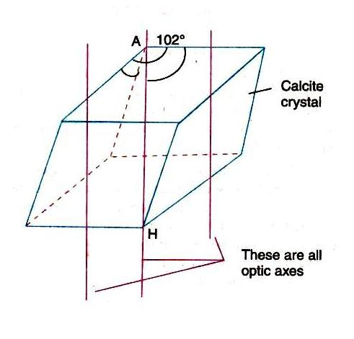

Slide 50
AH is the optic axis of calcite crystal.
If a ray of light is incident along the optic axis or in a direction parallel to the optic axis, then it will not split up into two rays.
Thus the phenomenon of double refraction is absent when the light is allowed to enter the crystal along the optic axis.

Slide 51
Principal Section
A plane containing the optic axis and perpendicular to a pair of opposite faces of the crystal is called the principal section of the crystal for that pair of faces.
As a crystal has six faces, so far every point inside the crystal there are three principal sections, one for each pair of opposite crystal faces.
A principal section cuts the crystal surfaces in a parallelogram having angles 71⁰ and 109⁰

Slide 52
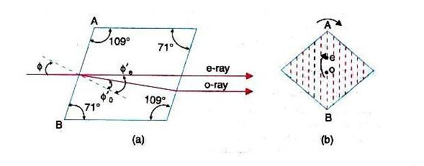

Slide 53
In fig(a) the principal section of the crystal is shown.
An end view of any principal section is a straight line (shown by dotted line in fig.b)
The plane containing the optical axis and the O -ray is called the principal plane of O -ray.
The plane containing the optic axis and the E-ray is called the principal plane of E-ray.

Slide 54
Double refraction
When a ray of light is refracted by a crystal of calcite it gives two refracted rays. This phenomenon is called "DOUBLE REFRACTION".

Slide 55
Positive crystal:
When reflective index for extraordinary ray is greater then that of O-ray µ_{e} > µ_{o.}
Negative crystal:
when reflective index for extraordinary ray is lesser then that of O-ray µ_{e} < µ_{o}

Slide 56
Mark an ink dot on a piece of paper.
If we place a calcite crystal over this dot, then two images of dots are observed.
Now rotate the crystal slowly as shown in figure ii.
It is found that one image remains stationary and the second image rotates with the rotation of the crystal.
The stationary image is known as the ordinary image
The second image is known as the extraordinary image.
The retracted ray which produces ordinary image is known as ordinary ray O-ray
The retracted ray which produces extraordinary image is known extraordinary ray (E-ray).

Slide 57
When a ray of light AB is incident in the calcite crystal making an angle of incidence i, it is refracted along two paths inside the crystal
Along BC making an angle of retraction r₂ and
Along BD making an angle of refraction r₁.
These two rays emerge out along CE and DO are parallel.

Slide 58


The difference between o-ray and e-ray is given below:
The ordinary ray has a refractive index µ₀ =
The extraordinary ray has a refractive index µ_{e} =
The o-ray obeys the laws of refraction and its refractive index is constant.
For e-ray its refractive index varies with the angle of incidence and it is not fixed.

Slide 59


For the case of calcite µ₀ > µ_{e} because r₁less than r_{2.}
Therefore, the velocity of light for the o-ray inside the crystal is less than the velocity of light for e-ray.
µ₀ = and µ_{e} =
The o-ray travels in the crystal with same velocity in all directions
The velocity of e-ray is different in different directions, because its refractive index varies.
Both o-ray and e-ray is plane polarized.
They are polarized in mutually perpendicular planes.

Slide 60
Huygens’ explanation of double refraction in uniaxial crystal
According to Huygens, the each point on a wave front acts as a fresh source of secondary wavelets.
He explained the phenomena of double refraction in uniaxial crystal with the help of secondary wavelets.
Theory:
When any wave front strikes a doubly refraction crystal, every point of the crystal becomes a source of two wavefronts.

Slide 61
Ordinary wavefront corresponding to ordinary rays.
Since ordinary rays have same velocity in all directions, the secondary wave front is spherical.
Extra-ordinary wavefront corresponding to extra-ordinary rays.
Since extra-ordinary rays have different velocities in different directions,
The extra-ordinary wave front is ellipsoid with optic axis as the axis of revolution.

Slide 62
The sphere and ellipsoid touch each other at points which lie on the optic axis of the crystal, because two velocity of ordinary and extra ordinary ray is same along the optic axis.
In certain crystals like calcite and tourmaline called the negative crystal
The ellipsoid lies outside the sphere as shown in fig.(a).

Slide 63
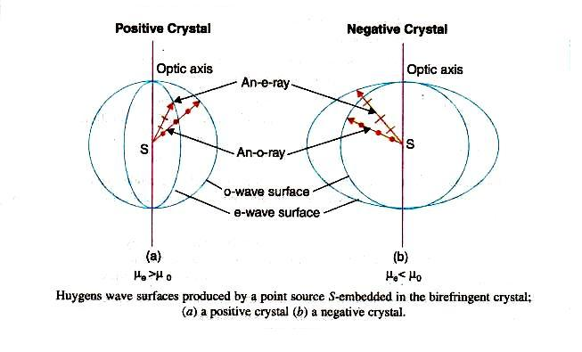

Slide 64
In negative crystals, the extra-ordinary wavefront travels faster than ordinary wavefront except along optic axis.
(v_{e}> v₀ and µ₀> µ_{e}).
In certain crystal (like quartz). Sphere lies outside the ellipsoid as shown in fig-b.
Such crystals are called positive crystals.
In the crystals, velocity of ordinary wavefront is greater than extraordinary wave front except along optic axis.

Slide 65
Positive Crystal and Negative Crystal:
Positive Crystal | Negative Crystal
In positive crystals the refractive index for e-ray is greater than refractive index for o-ray i.e. µ_{e}> µ_{o.} | In negative crystals the refractive index for o-ray is greater than reflective index for e-ray i.e. µ₀> µ_{e}
In positive crystals e-ray travels slower than o-ray in all directions except along the optic axis. V₀> V_{e} | In negative crystals o-ray travels slower than e- ray in all directions except along the optic axis i.e. V₀< V_{e}

Slide 66
According to Huygen's, ellipse corresponding to e-ray is contained within the sphere corresponding to o-ray | According to Huygen's, ellipse corresponding to e-ray lies outside the sphere corresponding to o-ray
Birefringence or amount of double refraction of a crystal is defined as Δµ=µ_{e}-.µ_{o} Δµ is positive quantity for positive crystals | Δµ is negative for negative crystals.
Example: Quartz | Example: calcite

Slide 67
Superposition of waves linearly polarized at right angles.
Let consider two light waves travelling in the x-direction
One wave is polarized in x-y plane and the other is polarized y-z plane.
Let us find the effect produced due to the super positions of these two waves.

Slide 68
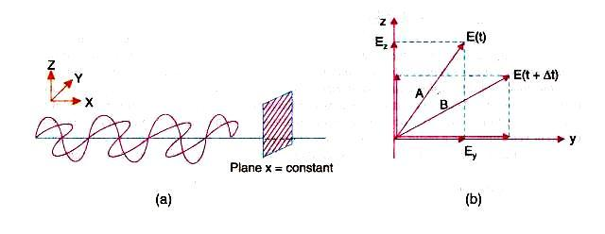

Slide 69

Two waves are represented as
Where, is phase difference between two waves
= frequency
According to the principle of superposition,

Slide 70


From equation- (2)
From equation- (1)

Slide 71

Rearranging above equation,
Squaring both the sides,

Slide 72


Dividing both side by E₂²

Slide 73
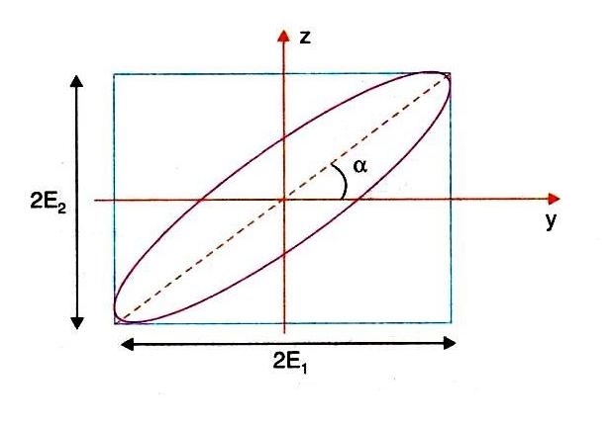
Above equation, is the general equation of ellipse
Hence, the tip of the resultant vector traces an ellipse in Y-Z plane.
The ellipse is constrained within a rectangle having sides 2E₁, and 2E₂.

Slide 74



Special cases:-
When , ,then two waves are in phase.

Slide 75

This is the equation represents a straight line, having a slope (E₂/E₁).
It means that, the resultant of two plane-polarized waves is again a plane-polarized wave.
When
The two waves are in opposite phase.

Slide 76



This equation represents a straight line of a slope (-E₂/E₁).

Slide 77


If,
This is the equation of ellipse.
Its major and minor axis considers with y-and z coordinates axes.
Thus the waves are out of phase by 90⁰ and their resultant wave is elliptically polarized wave.

Slide 78

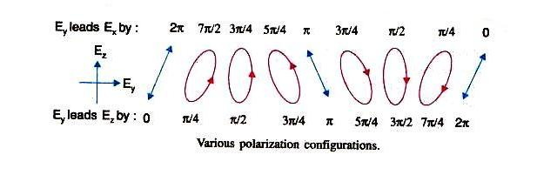
If,
Then, equation (4) reduced to,
This is the equation of circle. Hence result wave is circularly polarized.

Slide 79
TYPES OF POLARIZED LIGHT
Unpolarized light:-
It consists of sequence of wave trains, all oriented at random. It is considered as the resultant of two optical vectors components, which are incoherent.
Linearly polarized light:-
It can be regarded as a resultant of two coherent linearly polarized waves.
Partially polarized light:-
It is a mixture of linearly polarized light and unpolarized light.

Slide 80
Elliptically polarized light:-
It is the resultant of two coherent waves having different amplitudes and a constant phase difference of 90⁰.
In elliptically polarized light, the magnitude of electric vector E rotates about the direction of propagation.
If light is coming towards us, we would observe that tip of the E vector traces an ellipse.
The side view of E vector gives flattered helix in space.

Slide 81
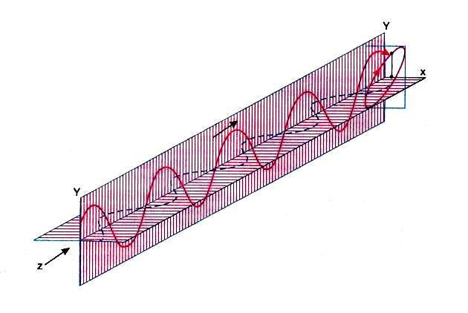
If we look from the source and rotation of E vector is clockwise then it is right elliptically polarized wave. If it is anti clock wise then it is left elliptically polarized wave.

Slide 82
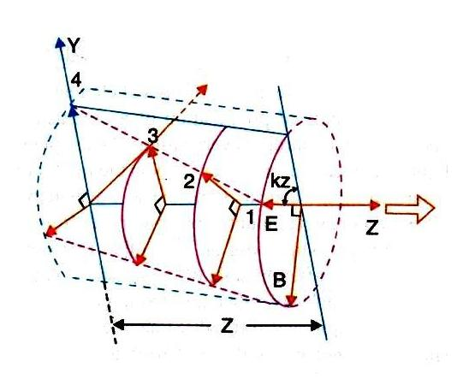
Circularly polarized light:-
It is the resultant of two coherent waves having same amplitudes and a constant phase difference of 90⁰. In this type of light the magnitude of E vector remains constant.

Slide 83
If light is coming towards us, we would observe that tip of the E vector trances a circle.
If we look from the source and rotation E vector is clockwise then it is said right circularly polarized and if it anticlockwise then it is left circularly polarized wave.

Slide 84
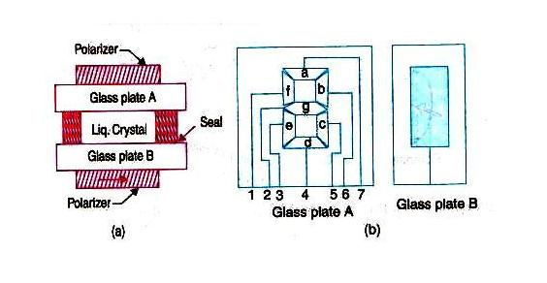
Liquid Crystal Display (LCD)
Liquid crystal Display is most widely used device which makes the use of polarization.
It is used in wristwatches, calculators, clocks, electronic instruments, video games etc.

Slide 85
Construction
An LCD consists of liquid crystal material of 10μm thickness.
It is double refracting material.
This material is supported between thing glass plates.
The inner surfaces of thin glass are coated with transparent conducting material.
This conducting material is etched in the form of a digit or character as shown in fig.2.
The assembly of glass plates with liquid crystal material is sandwiched between two crossed polarizer sheets.

Slide 86
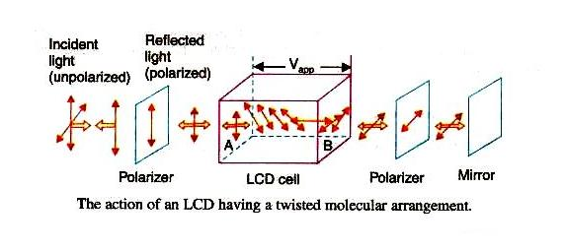
Working

Slide 87
During fabrication of LCD, the liquid crystal molecules are arranged as shown in fig.3.
This arrangement of molecules is called twisted molecular arrangement i.e. 90⁰. Rotation from plate A to B.
When natural light is incident on the LCD, the front polarizer converts it into linearly polarized light.
When this polarized light propagates through LCD, the optical vector is rotated by 90⁰ because of twisted molecular arrangement.
This light passes very easily through the rear polarizer whose transmission axis is perpendicular to that of the front polarizer.

Slide 88
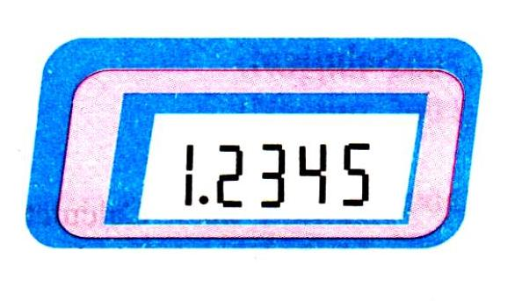
A reflecting coating at the back of the rear polarizer sends back the light, which comes out from the front polarizer.
The display seems illuminated uniformly.
When a voltage is applied to the device, the molecules between the electrodes align along the directions of field.
When light passes through this region optical vector does not undergo rotation.
The rear polarizer blocks the light and therefore a dark digit or character is seen in that region as shown in figure.

Slide 89
Thank You

