Slide 1
SYBSc English
US03AENG21
Topic 1
Email Writing

Slide 2
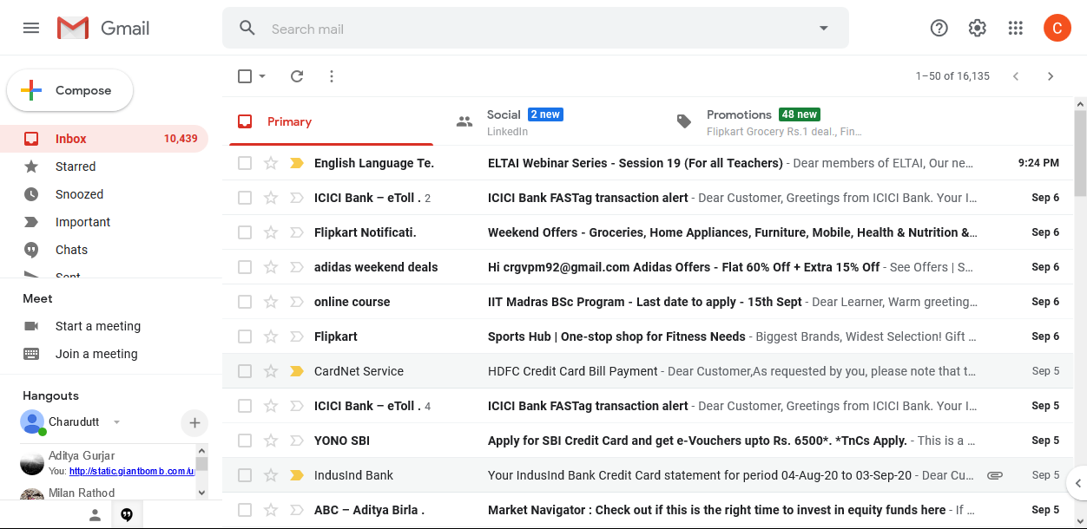

Slide 3
What is an E mail?
An Email is an electronic mail sent using a computer or a mobile phone and Internet.
What are the advantages of Email

Slide 4
Basic Email terms
Subject: This is the topic of the email, or what the email will be about.
Recipient: This is the person receiving (getting) the email.
Compose: This means to create or write the email. The word “compose” is usually used with music. A composer is someone who writes, or composes music.
Attachment: This is any file you’re attaching (adding) to the email.

Slide 5
CC: Carbon copy
It means that the same mail is sent to many other recipients. You can see all who have got the mail.
BCC means “blind carbon copy.” Just like CC, BCC is a way of sending copies of an email to other people. It’s called blind carbon copy because the other recipients won’t be able to see that someone else has been sent a copy of the email.

Slide 6
Basic Tips for E mails
Writing Effective Emails
Don't overcommunicate by email.
Make good use of subject lines.
Keep messages clear and brief.
Be polite.
Check your tone.
Proofread before sending

Slide 7
How to write an effective Email
The first step is to choose the appropriate format.
Format means how you are writing : formal, informal, friendly .Also keep in mind the audience: Who is going to read the mail?/ For whom is it intended)

Slide 8
Email Writing
Most of us in the business world use emails as the main, and in some cases the only means of written communication.
For many students studying Business English and practicing their business email writing skills is an important part of their course.

Slide 9
Subject line: This is a short phrase that summarizes the reason for your message or the goal of your communication. It is important to include a subject line when sending an email so your audience knows exactly what to expect and is able to locate the message easily if needed. Eg: Project presentation
Greeting/Salutation:
This is the first line of your email and generally acts as the greeting. For example:
Email body: The body of an email must contain the main message , and it must have a clear and specific purpose, such as getting some information or feedback on a presentation or arranging a meeting with a new client. It should also be concise. So that people actually read it, rather than skimming it and risking missing critical information. If possible be as precise as possible. Eg “Thank you for attending the new product presentation this afternoon. I’ve attached a video file of the full recording so you can share it with your team. Please let me know if you have any questions

Slide 10
Closing: This is the last line of your email before your signature and should wrap up your message. This is also where you may reiterate any requests you’ve made in the body of your message.
For example: I look forward to speaking with you on Wednesday. Thanks again!
Signature; The signature is where you identify yourself by name, title and any other information relevant to your communications. Most email programs allow you to set a fixed signature that’s automatically added to the end of every email you send.
Eg Sincerely,
Amit Sharma
Senior Software Engineer
ABC Company, Inc.”

Slide 11
Sending emails and letters
Salutations
Signing off
Dear Mr/ Mrs/ Ms/ Miss Sita
Dear Sir/ Madam
Dear Jay
Hi Jags
Yours sincerely/ Yours
Yours faithfully
(With) Best wishes/ Kind regards
See you soon/ Hear from you soon

Slide 12
Sending emails and letters
Opening phrases
In reply to your letter ... .
Thank you for your letter of May 14th concerning … .
Thanks for your email ... .
Following our phone conversation ... .

Slide 13
Reason for writing
This letter/ email is to ... .
I am writing to ... .
I am pleased to ... .
I’d be pleased if you ... .
Could you please ... .
Would you please ... .
Please email me ... .
Just a quick note to ... .
I am sorry to inform you ... .
Unfortunately ... .
I’m sorry about ... .
I apologize for ... .

Slide 14
Attaching and enclosing documents
I attach ... .
I enclose ... .
Please find enclosed … .

Slide 15
Closing Phrases
Please contact me again if you need any more information.
If I can be of any further assistance, please do contact me again.
Let me know if you need anything else.
I look forward to hearing from you.
Hear from you soon.
See you in Mumbai.
Take care.

Slide 16
TIPS FOR WRITING EMAILs
1) Use a neutral Email address( formal/business/ professional)
Your Email address should be a variation of your real name, not a username or nickname.
2) Subject Line
Always have a subject line that summarizes briefly and clearly the contents of the message (example: Re: Summary of Our Meeting with ABC Suppliers).

Slide 17
3) Use a proper salutation
Use the person's title (Mr. Mrs. Ms. or Dr.) with their last name, followed by a comma or a colon. Optionally, you can precede the salutation with "Dear..." (but "Hello..." is acceptable as well). Using a last name is more formal and should be used unless you are on first-name terms with the recipient.
If you don't know the name of the person you're writing to (but you really should try to find one) use "Dear Sir/Madam" or "Dear Sir or Madam" followed by a colon.

Slide 18
Introduce yourself in the first paragraph (if necessary).
Also include why you're writing, and how you found that person's Email address, or the opportunity you're writing about. Ex.
My name is Ashok Joshi . I'm contacting you to apply for the Administrative Assistant position listed on CareerXYZ.com

Slide 19
Write the actual message.
Be sure to get your point without confusing the reader: if it has too many detail and too long , the reader may lose interest and will not read important details
Try to break up the message into paragraphs by topic to make your message more logical and digestible.
The email should be no more than 5 paragraphs long and each paragraph should be no more than 5 sentences long.
Insert a line break between each paragraph

Slide 20
3. Think of who your reader is going to be
Is it a colleague, a client or your boss? Should the email be informal or formal? Most business emails these days have a neutral tone. Note the difference between Informal and Formal:
Informal – Thanks for emailing me on 15th February
Formal – Thank you for your email dated 15th February
Informal – Sorry, I can’t make it.
Formal – I am afraid I will not be able to attend
Informal – Can you…?
Formal – I was wondering if you could….?

Slide 21
Use the correct form of leave-taking.
This will depend on your level of intimacy with the recipient. Examples include:
Yours sincerely,
Yours cordially,
Respectfully,
Your student,

Slide 22
Sign with your full name.
If you have a job title, include that in the line after your name, and write the company name or website in the line after that.
If you do not have a job title but you have your own blog or website related to the content of the e-mail, include a link to that below your name.
If the e-mail is about a job, only include a career-related website or blog, not hobbies or interests

Slide 23
Proofread your message for content.
Make sure you haven’t omitted any important details (or repeated yourself).
Proof read for grammar and spelling errors.
Reading your email aloud or asking someone to proofread it is a great way to get a different perspective(point of view) on what you’ve written.

Slide 24
Email(Informal)
Hello Ashok
Just a quick note to confirm that I’m coming to Bangalore on May 5 and I’ll stay there until May 7. I hope we can meet to discuss our production requirements for next year. Please let me know when it would suit you.
See you soon
Ramesh

Slide 25
Business letter
New Tech Ltd
21 Hitech city
Hyderabad, India
Mr Ashok Joshi
Production manager, TSP Technologies
Georgen strasse 132
Berlin 3287
Germany
Dear Mr Ramesh
Re: Visit to Berlin
Further to our telephone conversation, I would like to confirm my next visit to Berlin. I hope to be in Berlin on May 5, 6 and 7, and I would be very pleased if we could meet to discuss our production requirements for next year. Please let me know when it would be convenient for you.
I look forward to hearing from you.
Yours sincerely
Ashok Joshi

Slide 26
Match the uses below with the phrases in the table
Payments Complaints Orders Clarifications Attachments Suggestions Apologizing Congratulations Closings Openings
Meetings Thanks Requests
Read the sentences and the function (at the end of the sentence in bold)
Uses:
We would like to offer our sincere apologies for the mistake(Apologies)
Attached please find the document(Attachments)
The document you have sent is not what we expected. There may have been a misunderstanding between us(Clarification)
I look forward to your reply(Closing)
Kindly send us the agreement draft (Request)

Slide 27
Payments Complaints Orders Clarifications Attachments Suggestions Apologizing Congratulations Closings Openings
Meetings Thanks Requests
We are very happy to receive a favorable reply from you
We are disappointed with the quality of your service
Your order no. 6739w, dated 26 Dec 2011 has been shipped today
Your payment on Order no. 6739w is due on 12th Jan 2012
Alternatively, you can directly contact out local office
Thanks
Complaints
Orders
Payments
Suggestions

Slide 28
Email Exercise
1. You are planning to go on a trip to meet family in USA . Write the details below.
Where are you going? _______________________________________________
What is the purpose of your trip? _______________________________________
How long are you going to stay? ____________________________________________
Why are you going? ______________________________________________________
What is your itinerary (the places you will visit)? _______________________________
Who will you meet? _______________________________________________________
How well do you know them? Have you written / spoken to / met them before? ______________________________________________________

Slide 29
Write two Emails
1) Write a letter to your English faculty in college( drcrgurjar@vpscience.org) apologising and explaining why could not attend classes last week.
2) Write an email to the Administrator (admin@vpscience.org) enquiring about displaying the merit list for SYBSc Admission and fee payment date.

Slide 30
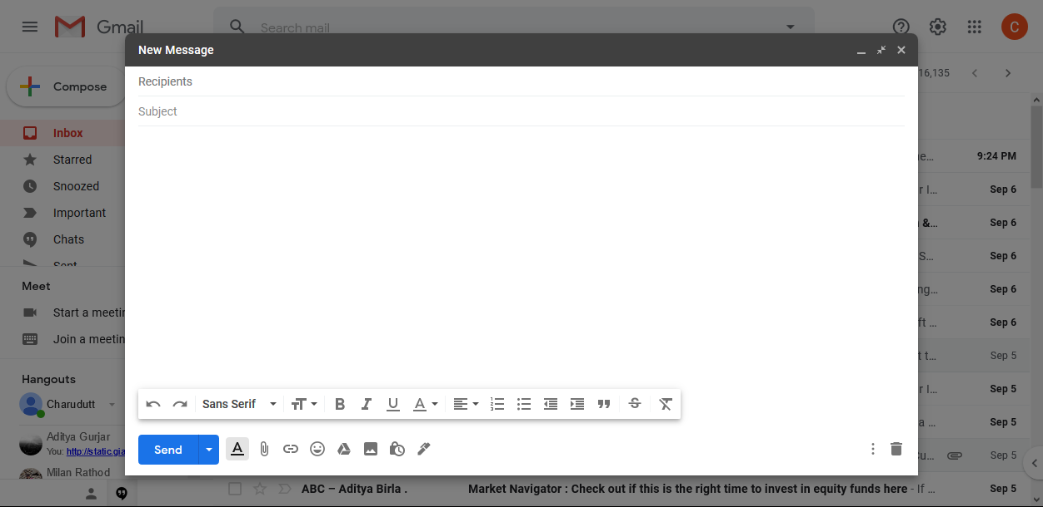

Slide 31
Thank you
Courtesy: onestopenglish.com, autoenglish.com, Brno University

